Slide 1
DETONATION SYNTHESIS MICRODIAMONDS
Blank V.D.*, Golubev A.A.*, Gorbachev V.A.** Dubitsky G.A.* Serebryanaya N.R. *, Shevchenko N.V.**and Deribas А.А.*
* Tehnological Institute for Superhard and Novel Carbon Materials
** FUGAS Petrovsky Research Centre, e-mail:pncfugas.ru

Slide 2
INTRODUCTION
A dynamic synthesis of detonation diamonds with nanoscale features, as well as static and dynamic synthesis of diamond micropowders, has been the dominant area of research in recent years [1-6.
Micron diamond synthesis technology is based on the methods of static and dynamic loading of graphite or carbon-containing substances. Diamond microparticles are formed under conditions corresponding to the lower boundary of the diamond stability in the phase diagram of carbon. This approach has been used over a long period by the “Du Pont de Nemours Company” for the detonation industrial production using the “Mypolex” diamond micropowder with the polycrystalline particles with a size up to several tens of micrometers [1]. Although this technology provides a number of fractions of diamond particles in the micron range dimensions, it has some disadvantages as it requires the use of a large amount of explosives (up to 5 tons) for a single blasting and has some restrictions on the product output in the synthesis of diamond micropowder.
The nanoscale diamonds are produced by the mechanical and chemical treatment of the solid residue remaining after the explosion– these are the detonation nanodiamonds (DND).
The detonation properties of the diamonds related to the nanocrystalline particles suggest a variety of applications and prospects for the production of these structures. Despite this, a field of DNA application, at present, is limited by the high cost of production and purification of nanodiamonds. A possible way out is to use the explosives obtained in the disposal of ammunition as a raw material for the detonation synthesis [6]. Another promising area is the development of a detonation diamond production technology with the particle sizes ranging from nano- to micrometers, supplying a wide range of consumers with these products.
This study is aimed at exploring the possibilities of the diamond microcrystals detonation synthesis using an explosive chamber, and a comprehensive study of the properties of the microcrystalline powders obtained by this method.

Slide 3
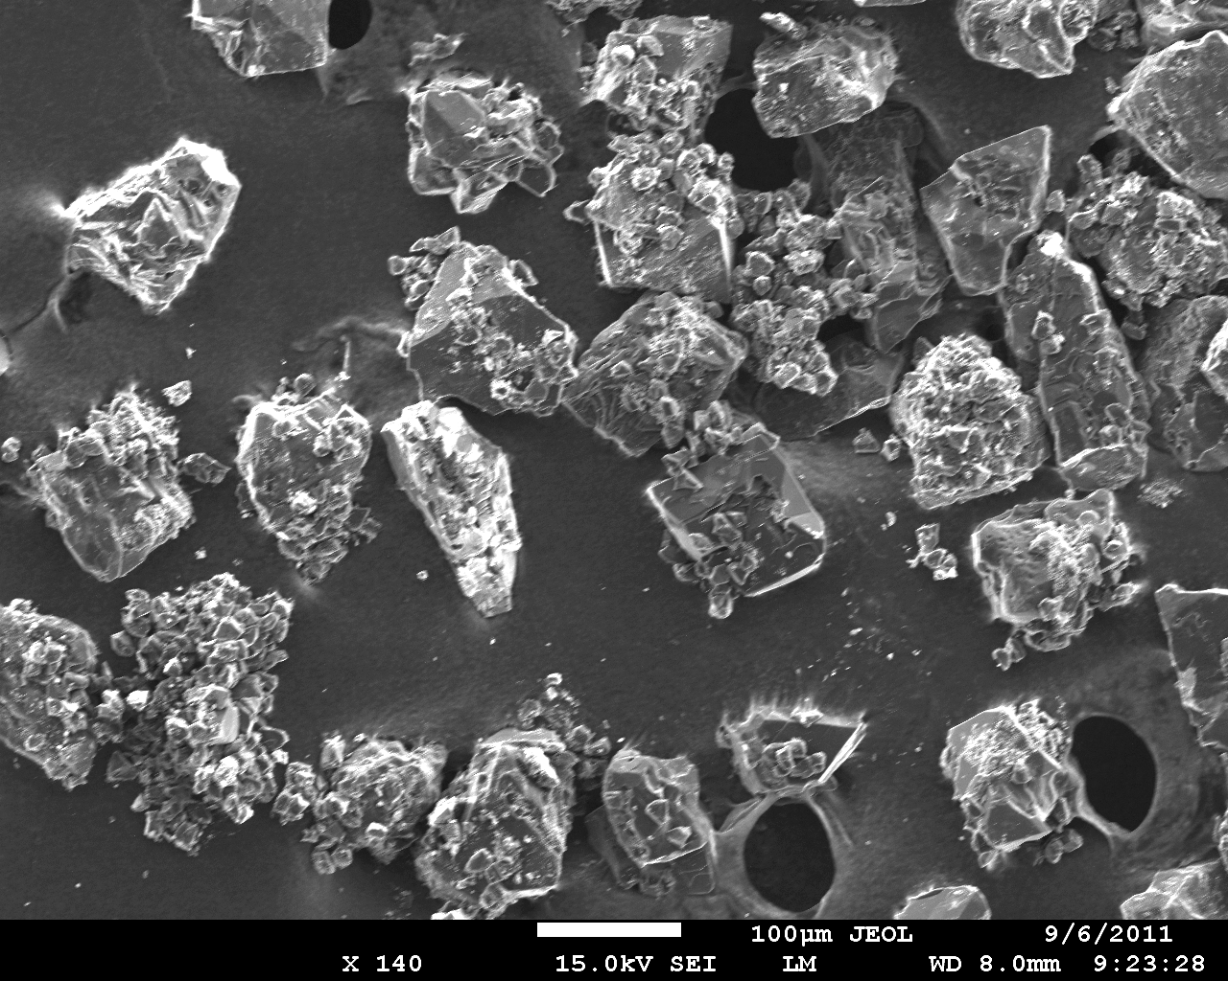
Fig.1 Micrographs of the typical detonation microdiamonds

Slide 4
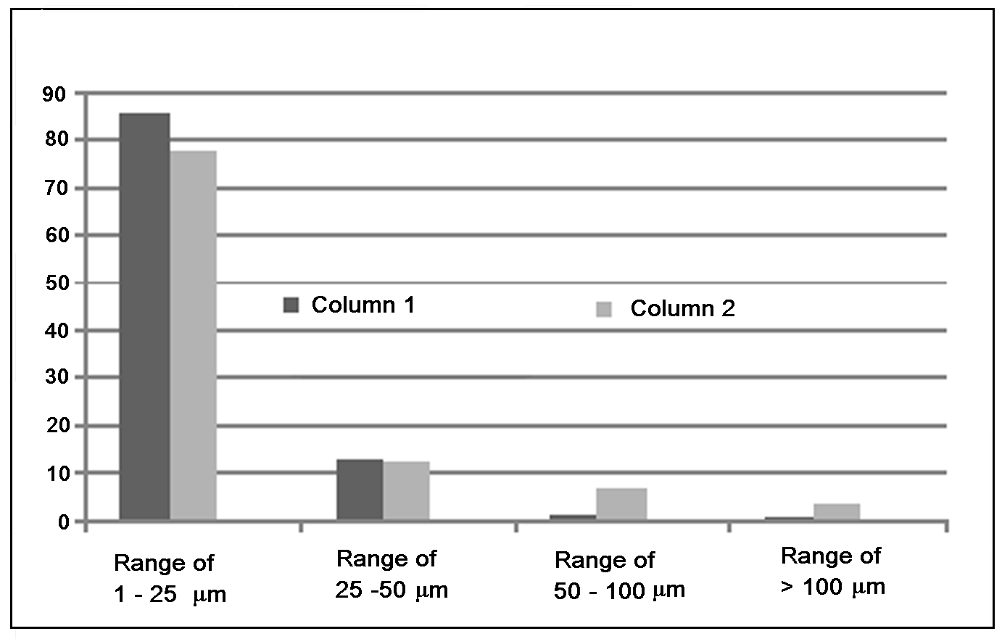
Fig. 2 Size distribution of the microdispersed particles of diamonds, percents of total number of particles.
Column 1. Size distribution of the diamond particles obtained by the optical measurements.
Column 2. Size distribution of the diamond particles obtained by the electron microscopic measurements.

Slide 5
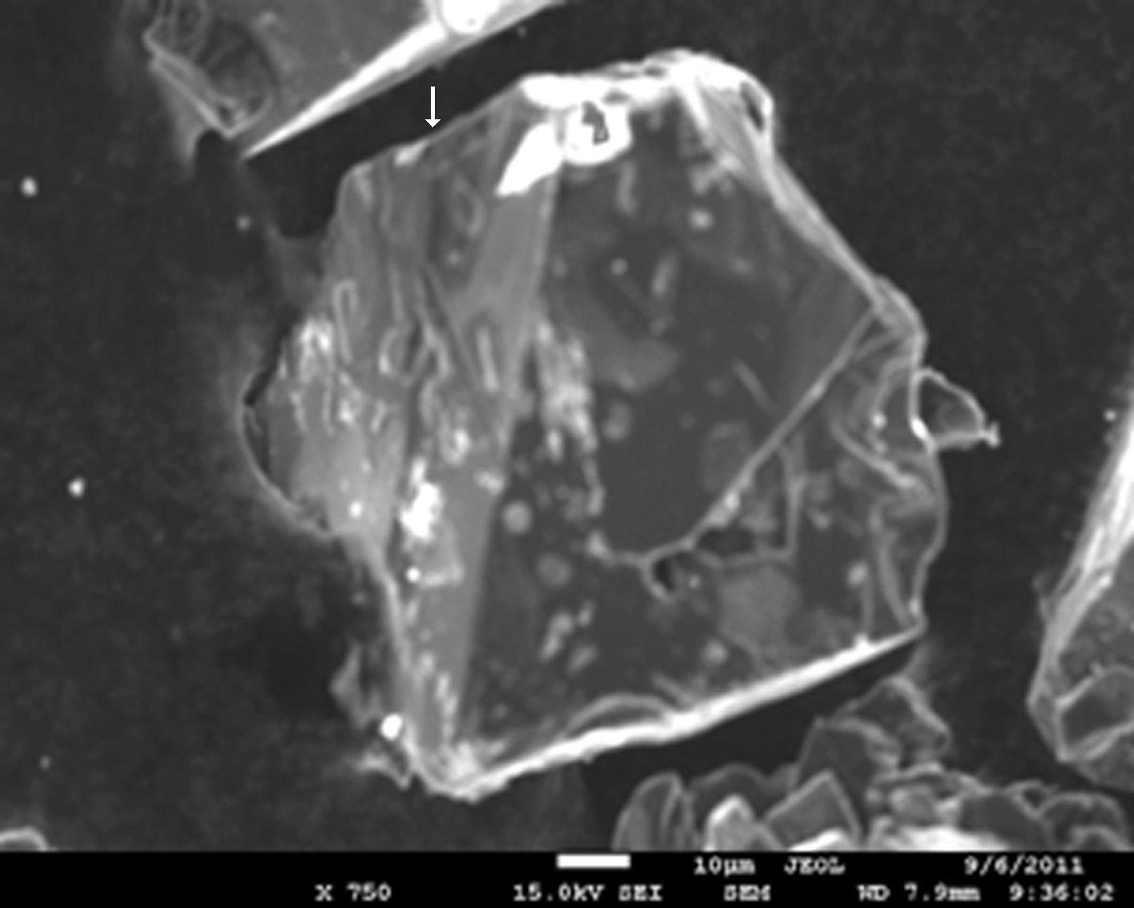
Fig. 3 A micrograph of a detonation microdiamond sample.

Slide 6
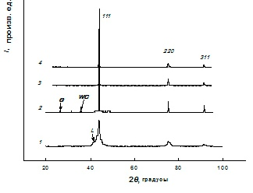
Fig. 4 Difractograms of the detonation diamonds.
1 - a Dalan type detonation nanodiamond;
2 – a detonation microdiamond manufactured during the present study;
3 – a compact of detonation microdiamonds after HPHT (7 GPa, 1400⁰ C);
4 – a compact of detonation microdiamonds after HPHT (12 GPa, 1400⁰ C).

Slide 7
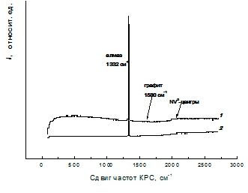
Fig. 5 Raman spectra of the detonation microdiamonds.

Slide 8
CONCLUSION REFERENCES
The research results showed the possibility of obtaining the diamond microcrystals in the detonation synthesis process in an aqueous medium, using TNT as an explosive. The appearance of the diamond micro-particles in the charge is recorded by the optical and electron microscopy, X-ray analysis and Raman scattering. The detonation synthesis conditions provide the diamond phase particle formation in the size range from 1 to 140 microns, with sharp edges and a characteristic shine in the optical range. Further studies will provide more detailed characteristics of the synthesized diamond microparticles and identify the areas for their further application.
1. Decarly P.S., Jamison T.S. Formations of diamond by explosive shock. Science, 1961. V. 133. 3466. P. 1821 – 1823.
2. Даниленко В.В. Синтез и спекание алмазов.М.: Энергоатомиздат. 2003. 272 с.
3. Бугров Н.В., Захаров Н.С. О возможности лазерного синтеза алмазов . Изв. АН СССР Сер. Физ. 1991. Т.55. № 7. С.1444-1447.
4. Гордюхин А.А., Горбачёв В.А. , Дерибас А.А., Чобонян В.А., Шевченко Н.В. Актуальные проблемы организации промышленного получения детонационного наноуглерода из утилизируемых взрывчатых веществ. Информационно-аналитический журнал. Вооружение. Политика. Конверсия. 2009, №4(88), С. 34-39.
5. Бланк В.Д., Голубев А.А., Горбачёв В.А. , Гордюхин А.А., Дерибас А.А., Чобонян В.А., Шевченко Н.В. Детонационный синтез углеродных материалов при использовании смесей взрывчатых веществ (ВВ) утилизируемых боеприпасов (БП). Тез. докл. 6-ой международной конф. «Углерод: фундаментальные проблемы науки, материаловедение, технология». Троицк, 2009. С. 227.
6. Zaitsev A. M.. Optical properties of diamond. A data handbook.// Springer-Verlag Berlin Heidelberg New York, 2001, P. 502. ISBN 3-540-66582-x.
7. Blank V. D., Dubitsky G. A., Serebryanaya, B. N.Mavrin, V. N. Denisov, S. G. Buga, L. A. Chernozatonskii. Physica B, 2003, v. 339, P. 39-44.

Slide 9
THANK YOU FOR ATTANTION!

