Slide 1
Elemental doping and phase transition of TiO2 induced by shock waves
Pengwan CHEN, Xiang GAO, Naifu CUI, Jianjun LIU*
Beijing Institute of Technology
*Beijing University of Chemical Technology

Slide 2
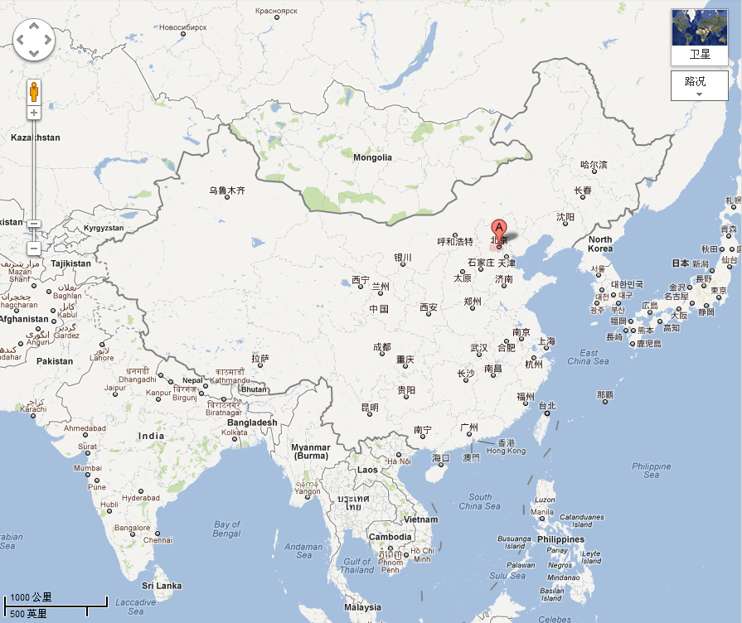

Slide 3
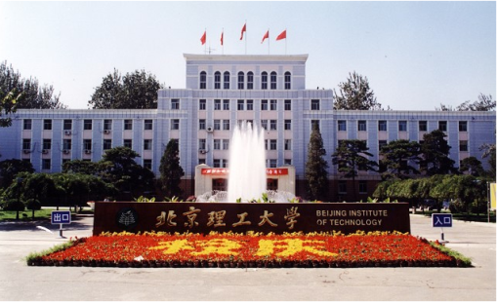


Slide 4
Beijing Institute of Technology (BIT) was founded in 1940;
3,500 teachers and research staff;
51,000 students, including 8,200 master students , 2,500 Ph.D students;
5 campuses, 18 schools.

Slide 5

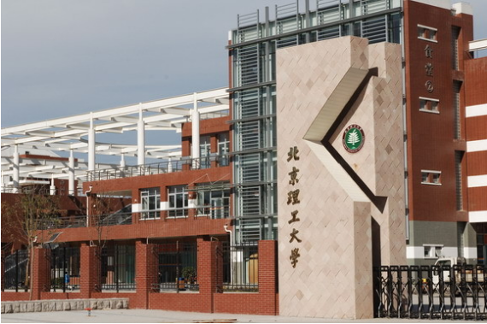

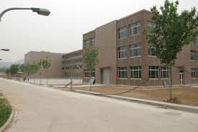
BIT Main Campus
LiangXiang Campus
Zhuhai Campus
West Mountain Campus

Slide 6
State Key Laboratory of Explosion Science and Technology (SKLEST)
Research areas:
Theory and Applied Technology of Energetic Materials;
Detonation and Explosion Technology;
Impact Dynamics of Materials;
Explosion Effects and Protection Technology;
Explosion Safety and Assessment.

Slide 7
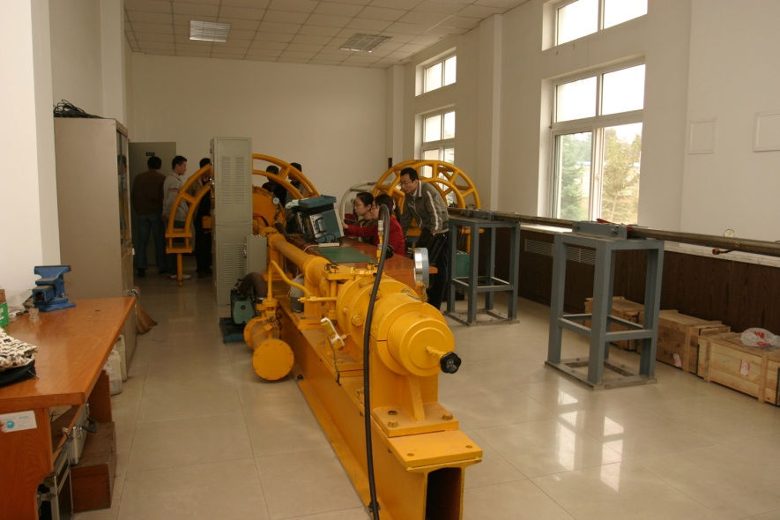
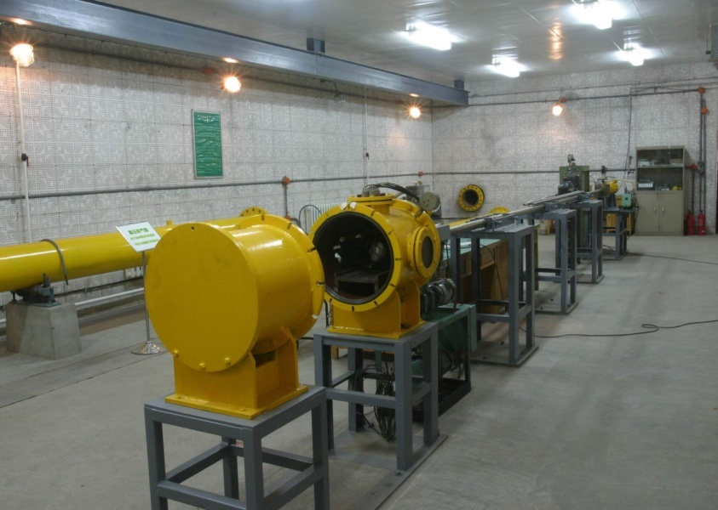
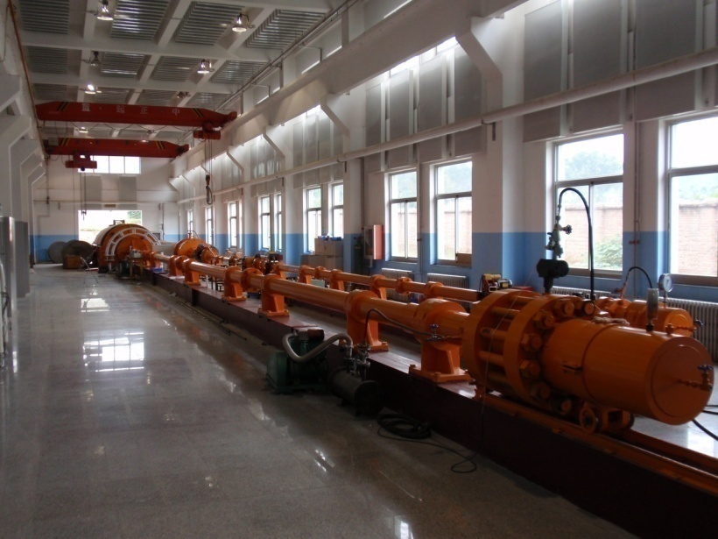
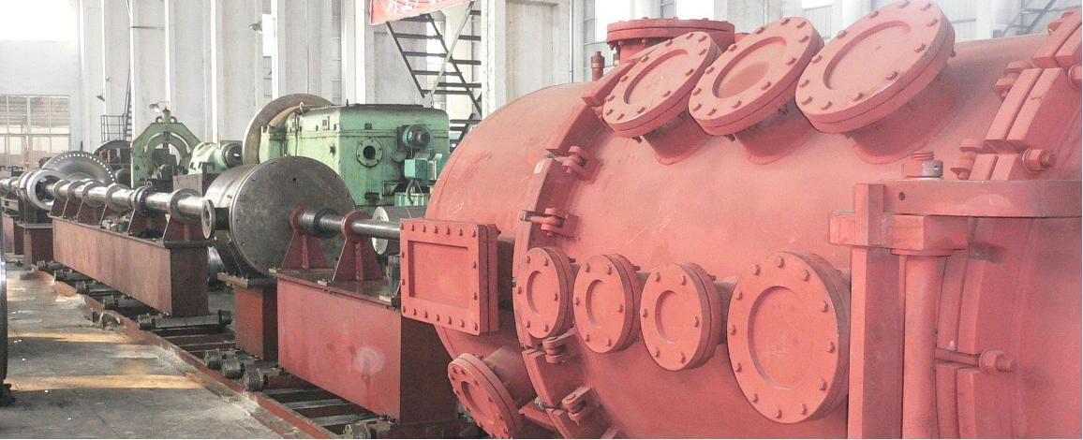
Facilities
Φ 57mm gas gun
Φ 37mm gas gun
two-stage gas gun
three-stage gas gun (under construction)

Slide 8
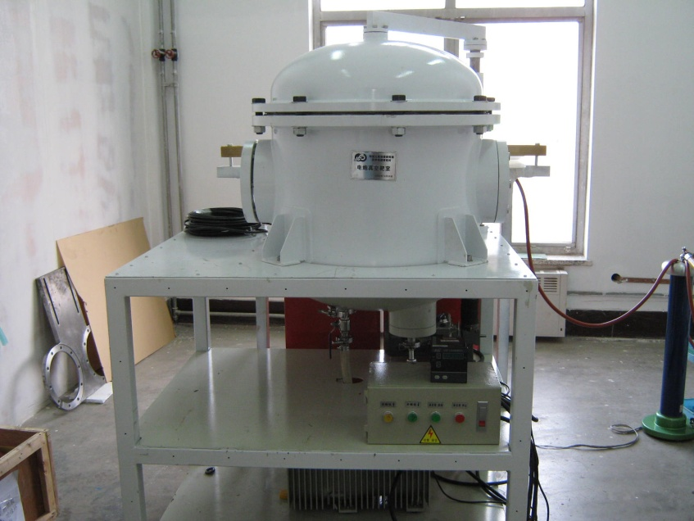
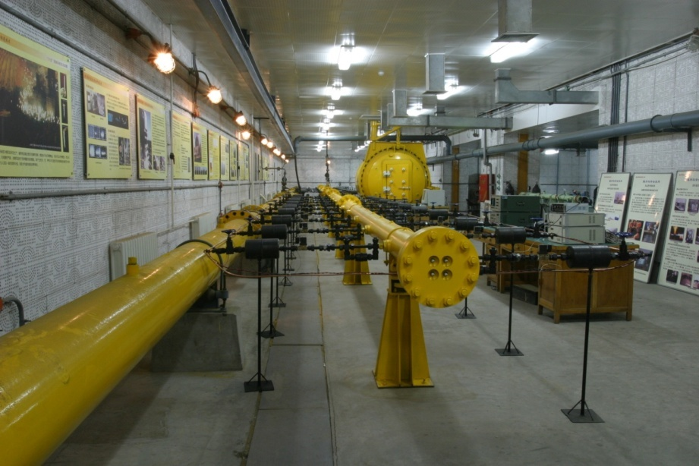
Facilities
Electric gun
Shock wave tube

Slide 9
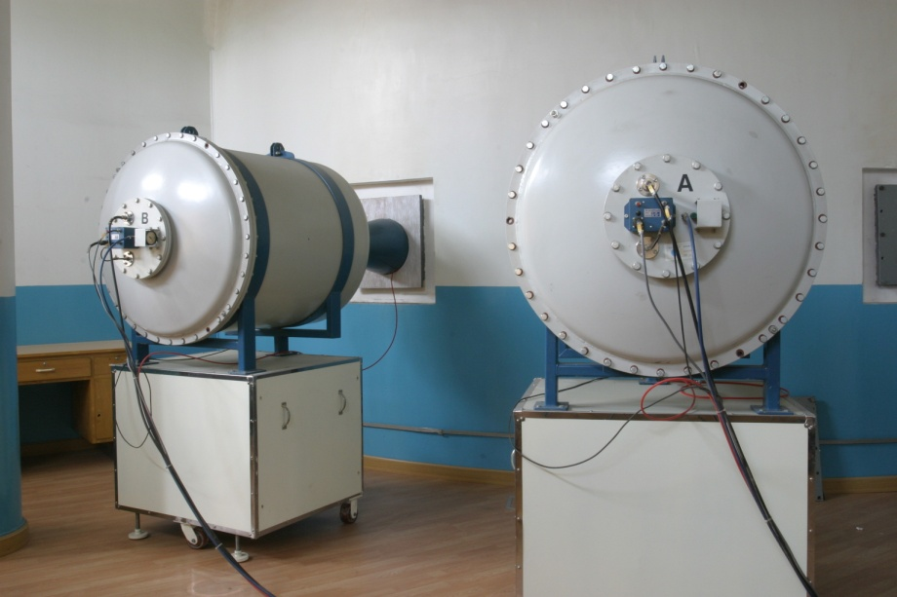
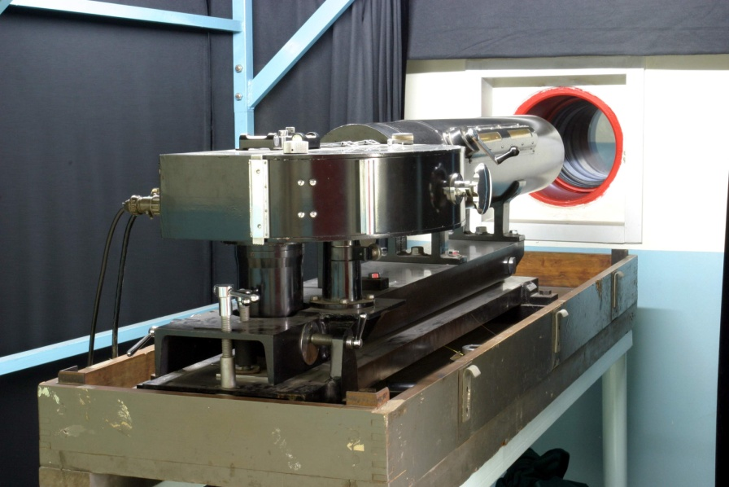
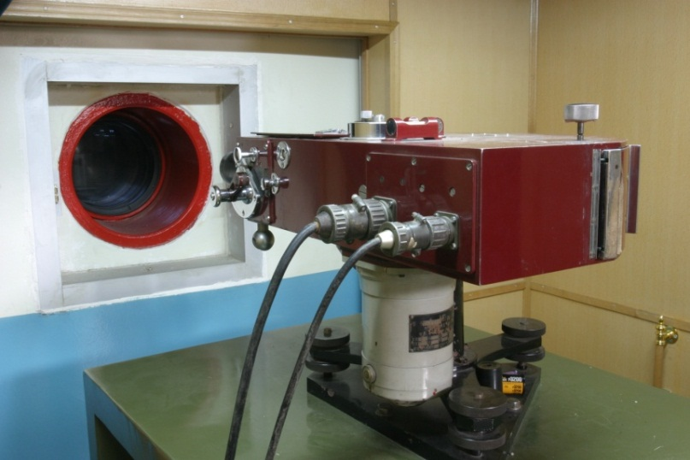
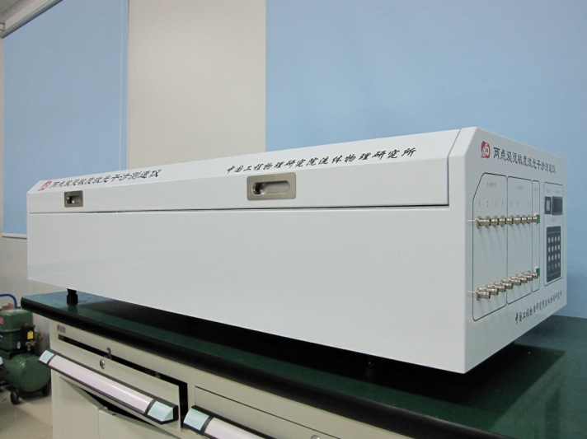
Facilities
Explosion chamber and Flash x-ray
High speed camera
VISAR

Slide 10
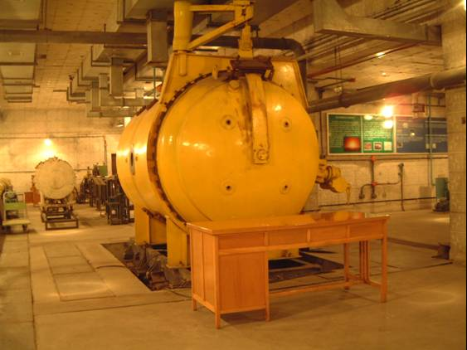
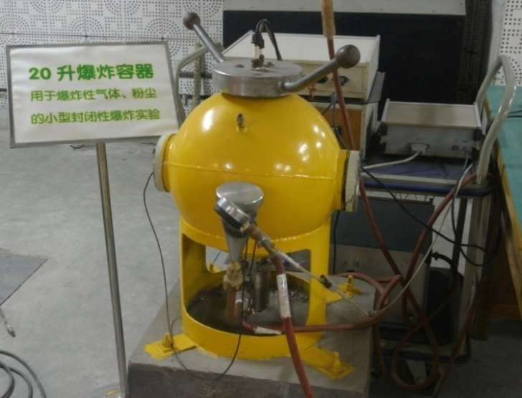
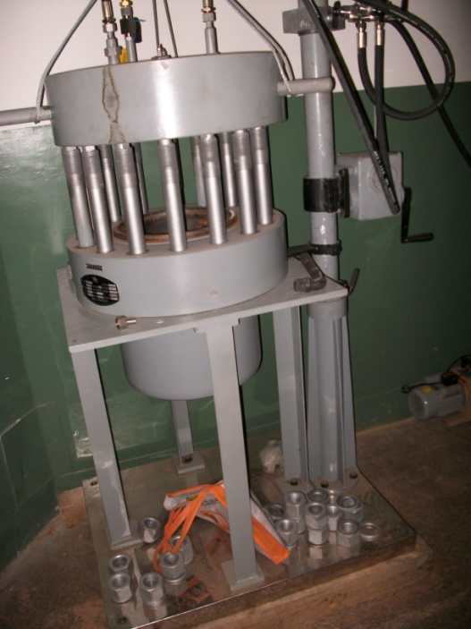
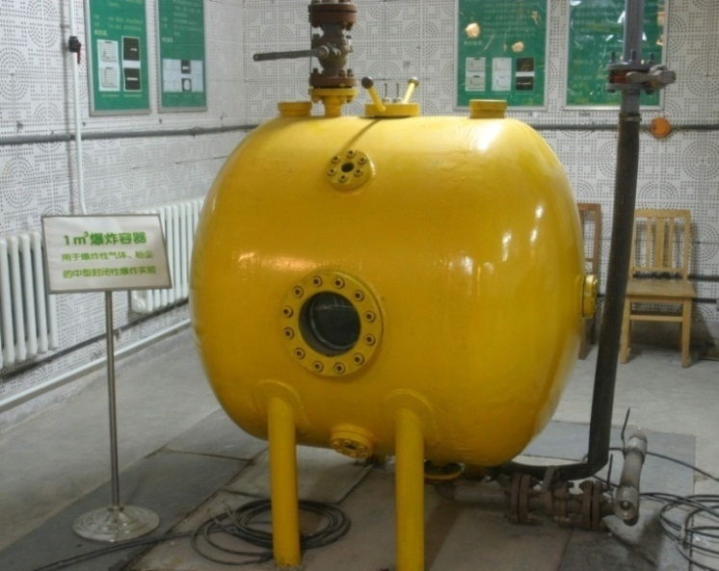
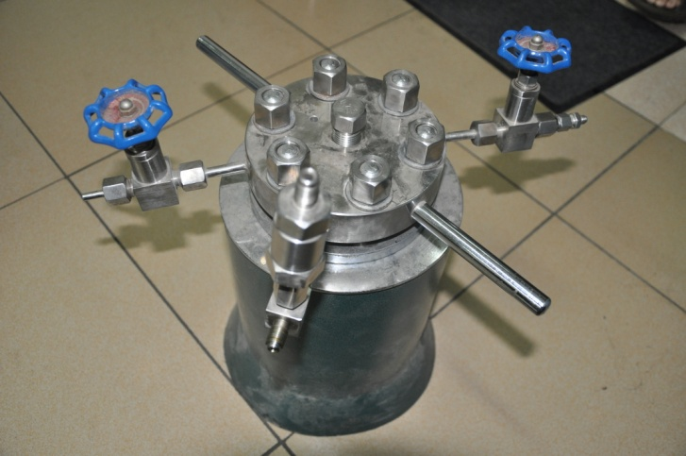
Explosion chamber

Slide 11
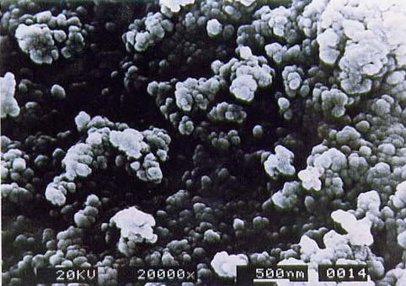
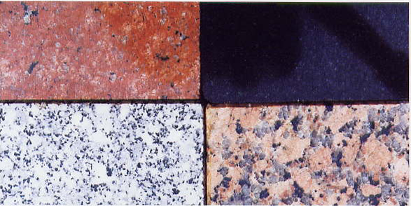
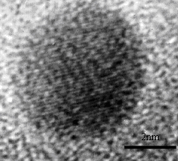
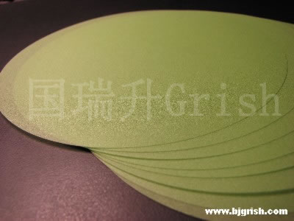
Shock-synthesized diamond
Detonation-synthesized diamond

Slide 12
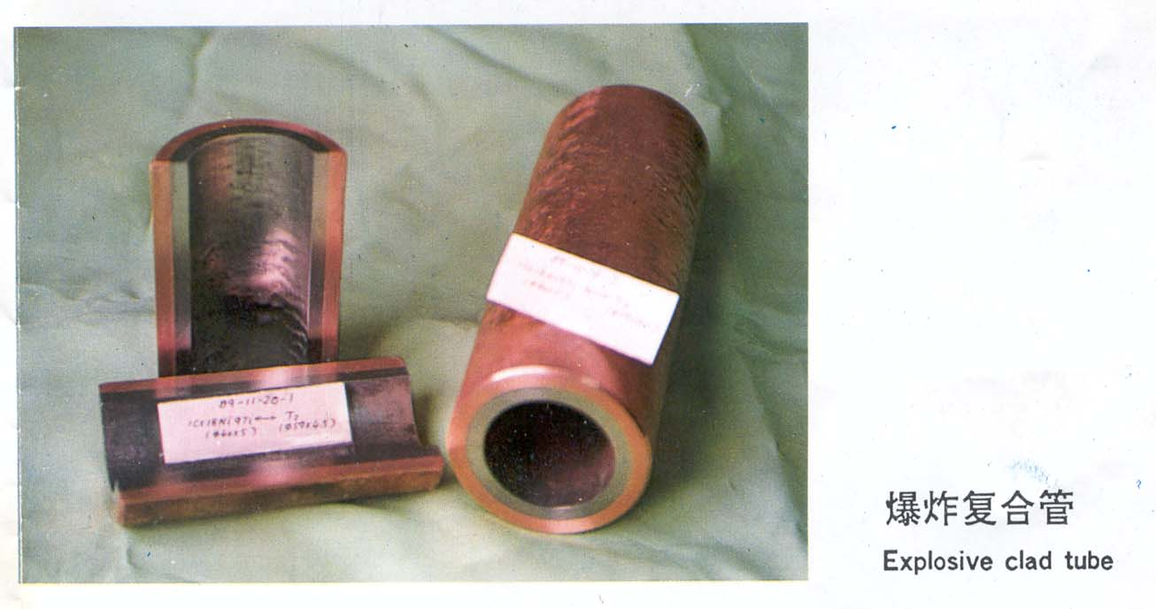
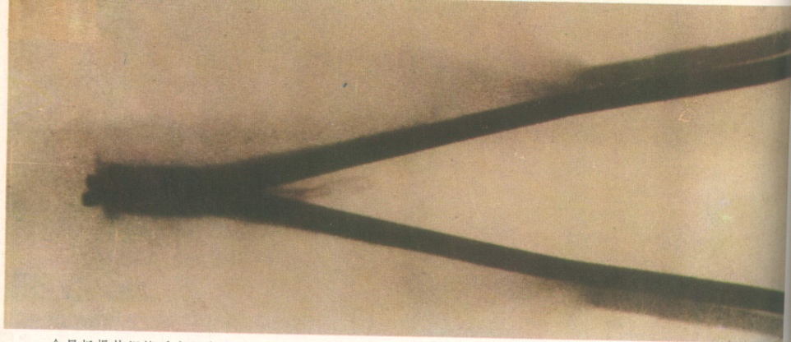
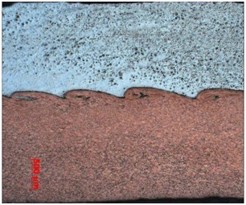
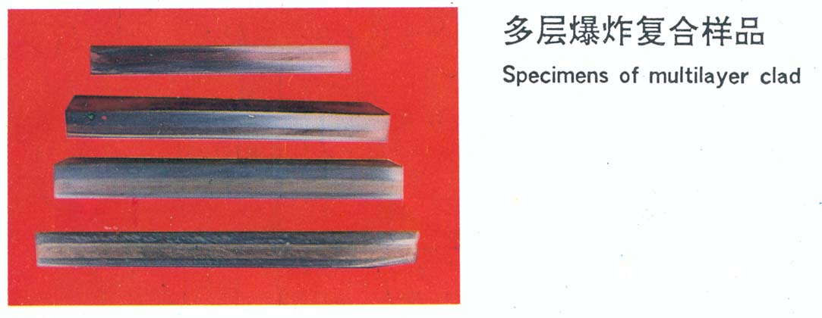
Explosive welding

Slide 13
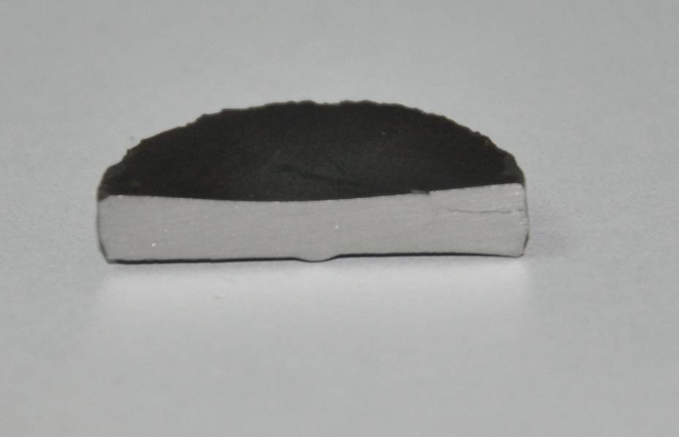
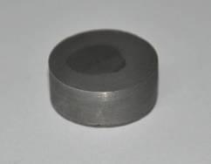
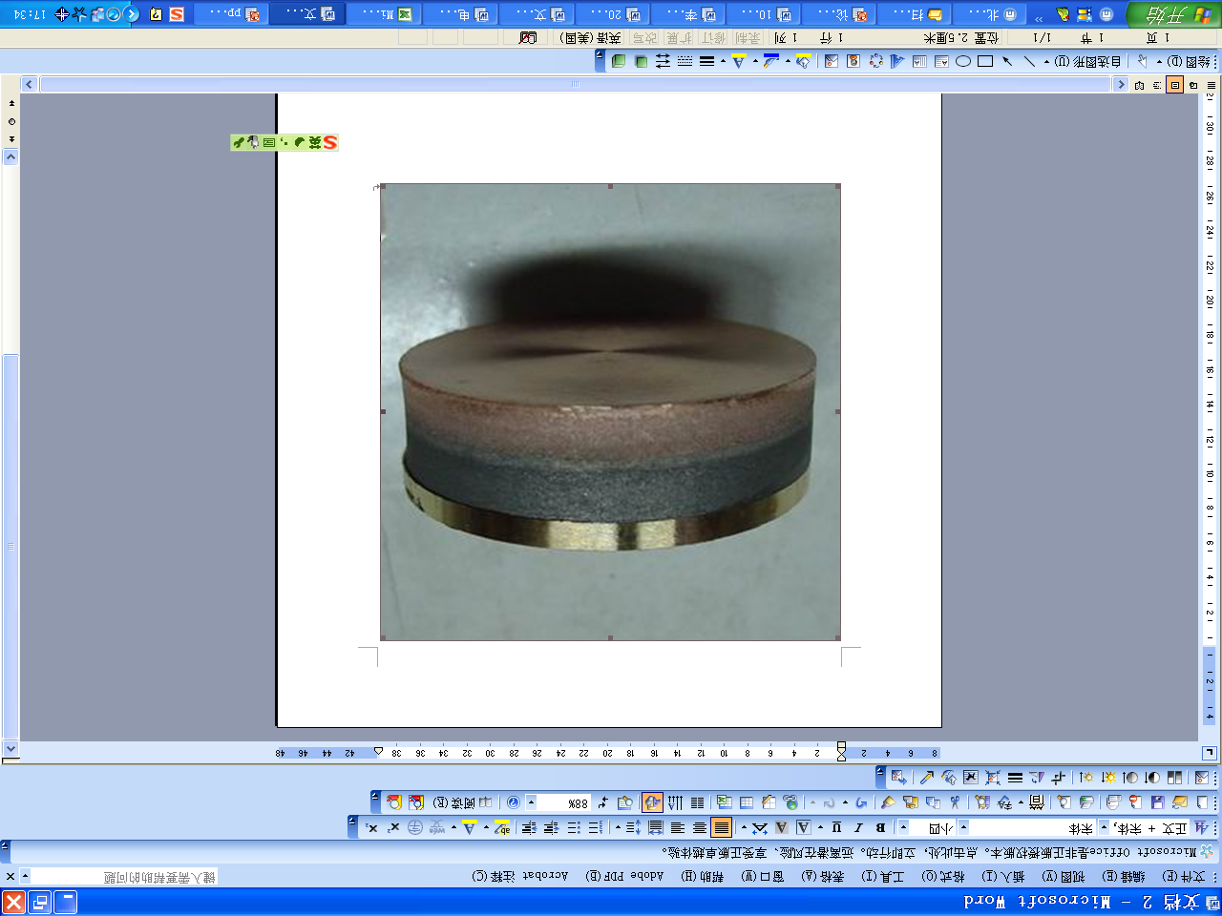
Explosive hardening
Explosive powder compaction

Slide 14
Explosive welding in China
More than 10 plants dealing with explosive cladding;
Output value of explosive clad metals is ¥6-7 billion ($1 billion) in 2011;
About 15 research institutes engaged in explosive production of new materials;
National conference on explosive synthesis of materials is held every year.

Slide 15

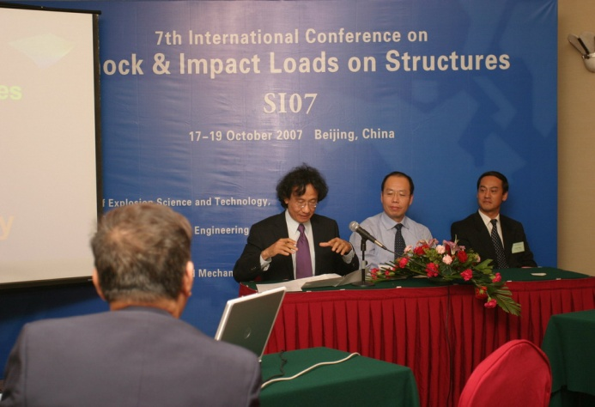
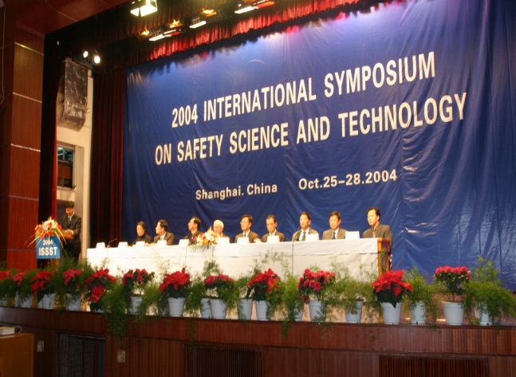
International conferences organized
International Explosives, Propellant and Pyrotechnic Symposium
International Safety Science and Technology Symposium
International Workshop on Intensive Loading and Its Effects

Slide 16
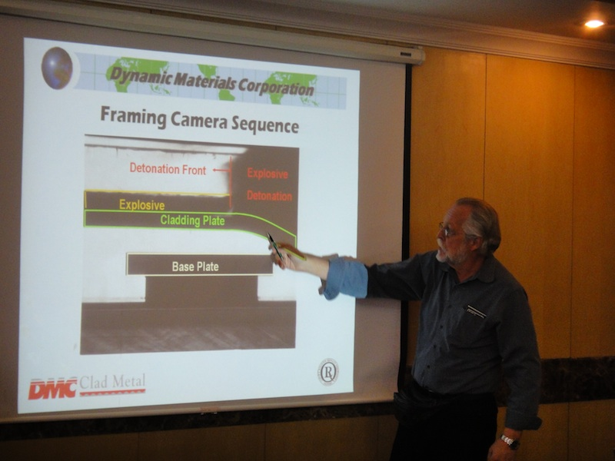
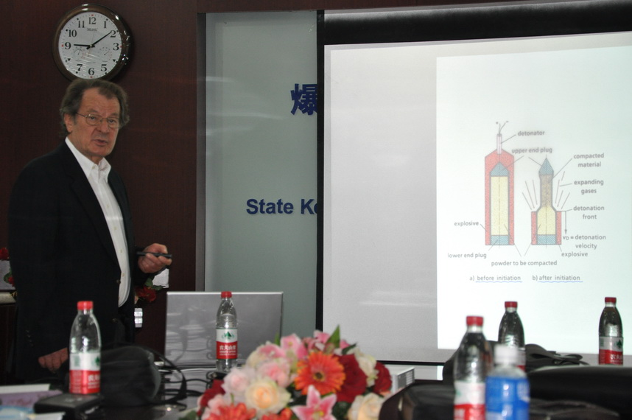
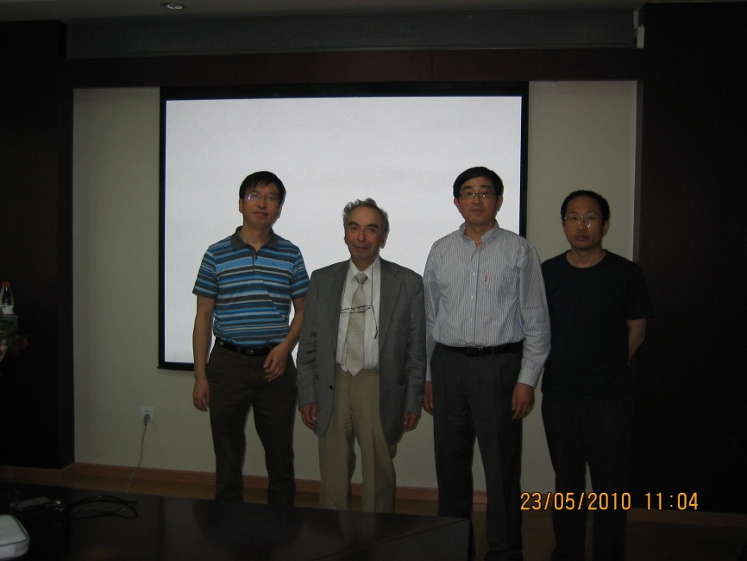

Academic exchange

Slide 17
Outline
1
Introduction
2
Shock induced doping of TiO2
3
Shock synthesis of high pressure phase of TiO2
4
Photoresponse properties of shock treated TiO2

Slide 18
Elemental doping of TiO2
TiO₂ semiconductor has oxidative capacity, chemical stability and low cost advantages.
Main drawback: energy gap is rather large, thus TiO₂ is only active in the ultraviolet region (λ<420 nm) accounting for less than 5% of the natural solar light.
Element-doped TiO₂ will enhance visible-light absorption and reduce energy gap.
Conventional doping methods: Sputtering; Ion implantation; Chemical vapor deposition; Hydrolysis.

Slide 19
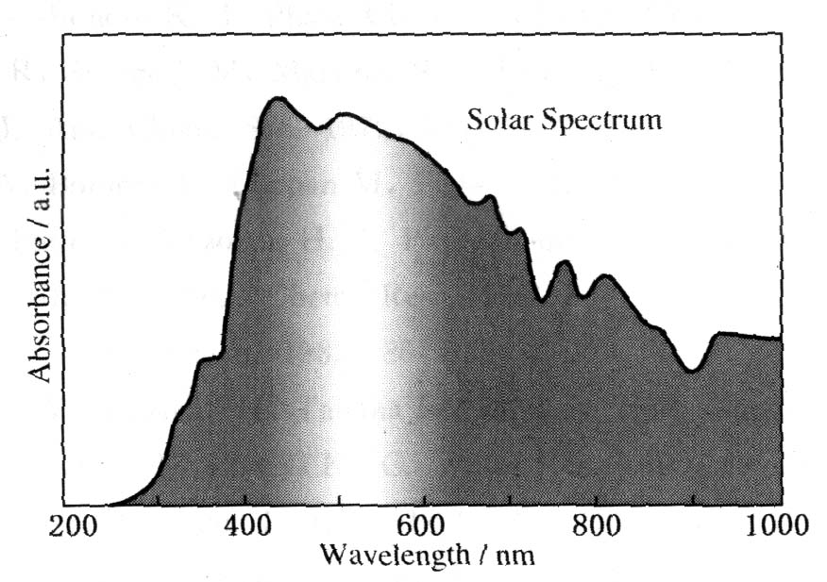
Elemental doping of TiO2
TiO₂(anatase)
E_{g}=3.2eV;
λ_{ex}<387nm
E_{t} <3%

Slide 20
Phase transition of TiO2
Three common phases of TiO₂ in nature
Anatase (Eg=3.2 eV)
rutile (Eg=3.2 eV)
brookite (Eg=3.4 eV)
High-pressure phases (Srilankite, columbite, baddeleyite, fluorite) may exhibit different electronic and optical.
Srilankite TiO2 has been observed by shock induced phase transition, but pure phase has not been obtained.

Slide 21
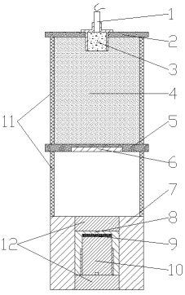
Materials
Precursors for doping:
P25 TiO₂ (15-20 nm)
H2TiO₃
Nitrogen doping resources :
dicyandiamide (DCD, C₂N₄H₄)
hexamethylene tetramine (HMT, C₆N₄H₁₂)
sodium amide (NaNH₂)
ammonium nitrate(NH4NO3)
Precursor for high-pressure phase synthesis:
MC-150 TiO₂ ( 5 nm)
T2 TiO₂ ( 100 nm)

Slide 22
Content
1
Introduction
2
Shock induced doping of TiO2
3
Shock synthesis of high pressure phase of TiO2
4
Photoresponse properties of shock treated TiO2

Slide 23
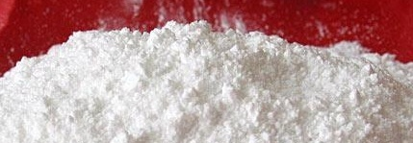

Effects of shock wave intensity
Cutoff
wave
Length
(nm)
Anatase
Phase
Content
(%)
Rutile
Phase
Content
(%)
Srilankite
Phase
Content
(%)
Flyer
Velocity
(km/s)
Shock
Pressure
(Gpa)
Shock
Temperature
(K)
Band-gap
Width
(ev)
N-doped
Concentr
ation(at%)
sample
-
-
-
-
P25 TiO2
400
3.10
85.3
14.7
0
P25 TiO2 +10wt% C2N4H4
1.20
6.3
700
435
2.85
3.67
81.9
18.1
0
P25 TiO2 +10wt% C2N4H4
1.90
11.9
1300
698
1.78
9.22
67.7
21.0
11.3
P25 TiO2 +10wt% C2N4H4
2.25
15.8
1800
710
1.75
11.28
50.7
27.5
21.8
P25 TiO2 +10wt% C2N4H4
2.52
18.3
2000
730
1.70
13.45
46.9
30.1
23.0
P25 TiO2 +10wt% C2N4H4
3.37
29.4
2700
765
1.62
13.58
21.1
24.9
54.0

Slide 24
XRD analysis
Srilankite content (%)
54
23
21.8
11.3
0
XRD patterns of shock-recovered samples at different conditions
Unshocked P25 TiO₂ (a),
shock-recovered C serial sample(P25+C₂N₄H₄(10%)) at 1.20km/s (b),
1.90km/s (c), 2.25km/s (d), 2.52km/s (e) and 3.37km/s (f)

Slide 25
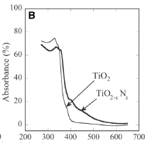
Phase change
Absorbance
f
Nitrogen doping
b
Shock induced Activation
e
c
d
a
200
300
400
500
600
700
800
Wavelength/(nm)
UV-vis Spectra of Recovered sample
P25 TiO₂ raw material (a); shocked P25 TiO₂ (b);
shock-recovered A, B, C serial samples at 2.25km/s (c, d, e)
A: P25+C₂N₄H₄ (1%), B: P25+C₂N₄H₄ (5%), C: P25+C₂N₄H₄ (10%)

Slide 26
Content
1
Introduction
2
Shock induced doping of TiO2
3
Shock synthesis of high pressure phase of TiO2
4
Photoresponse properties of shock treated TiO2

Slide 27
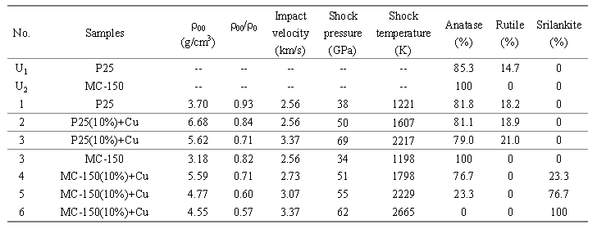
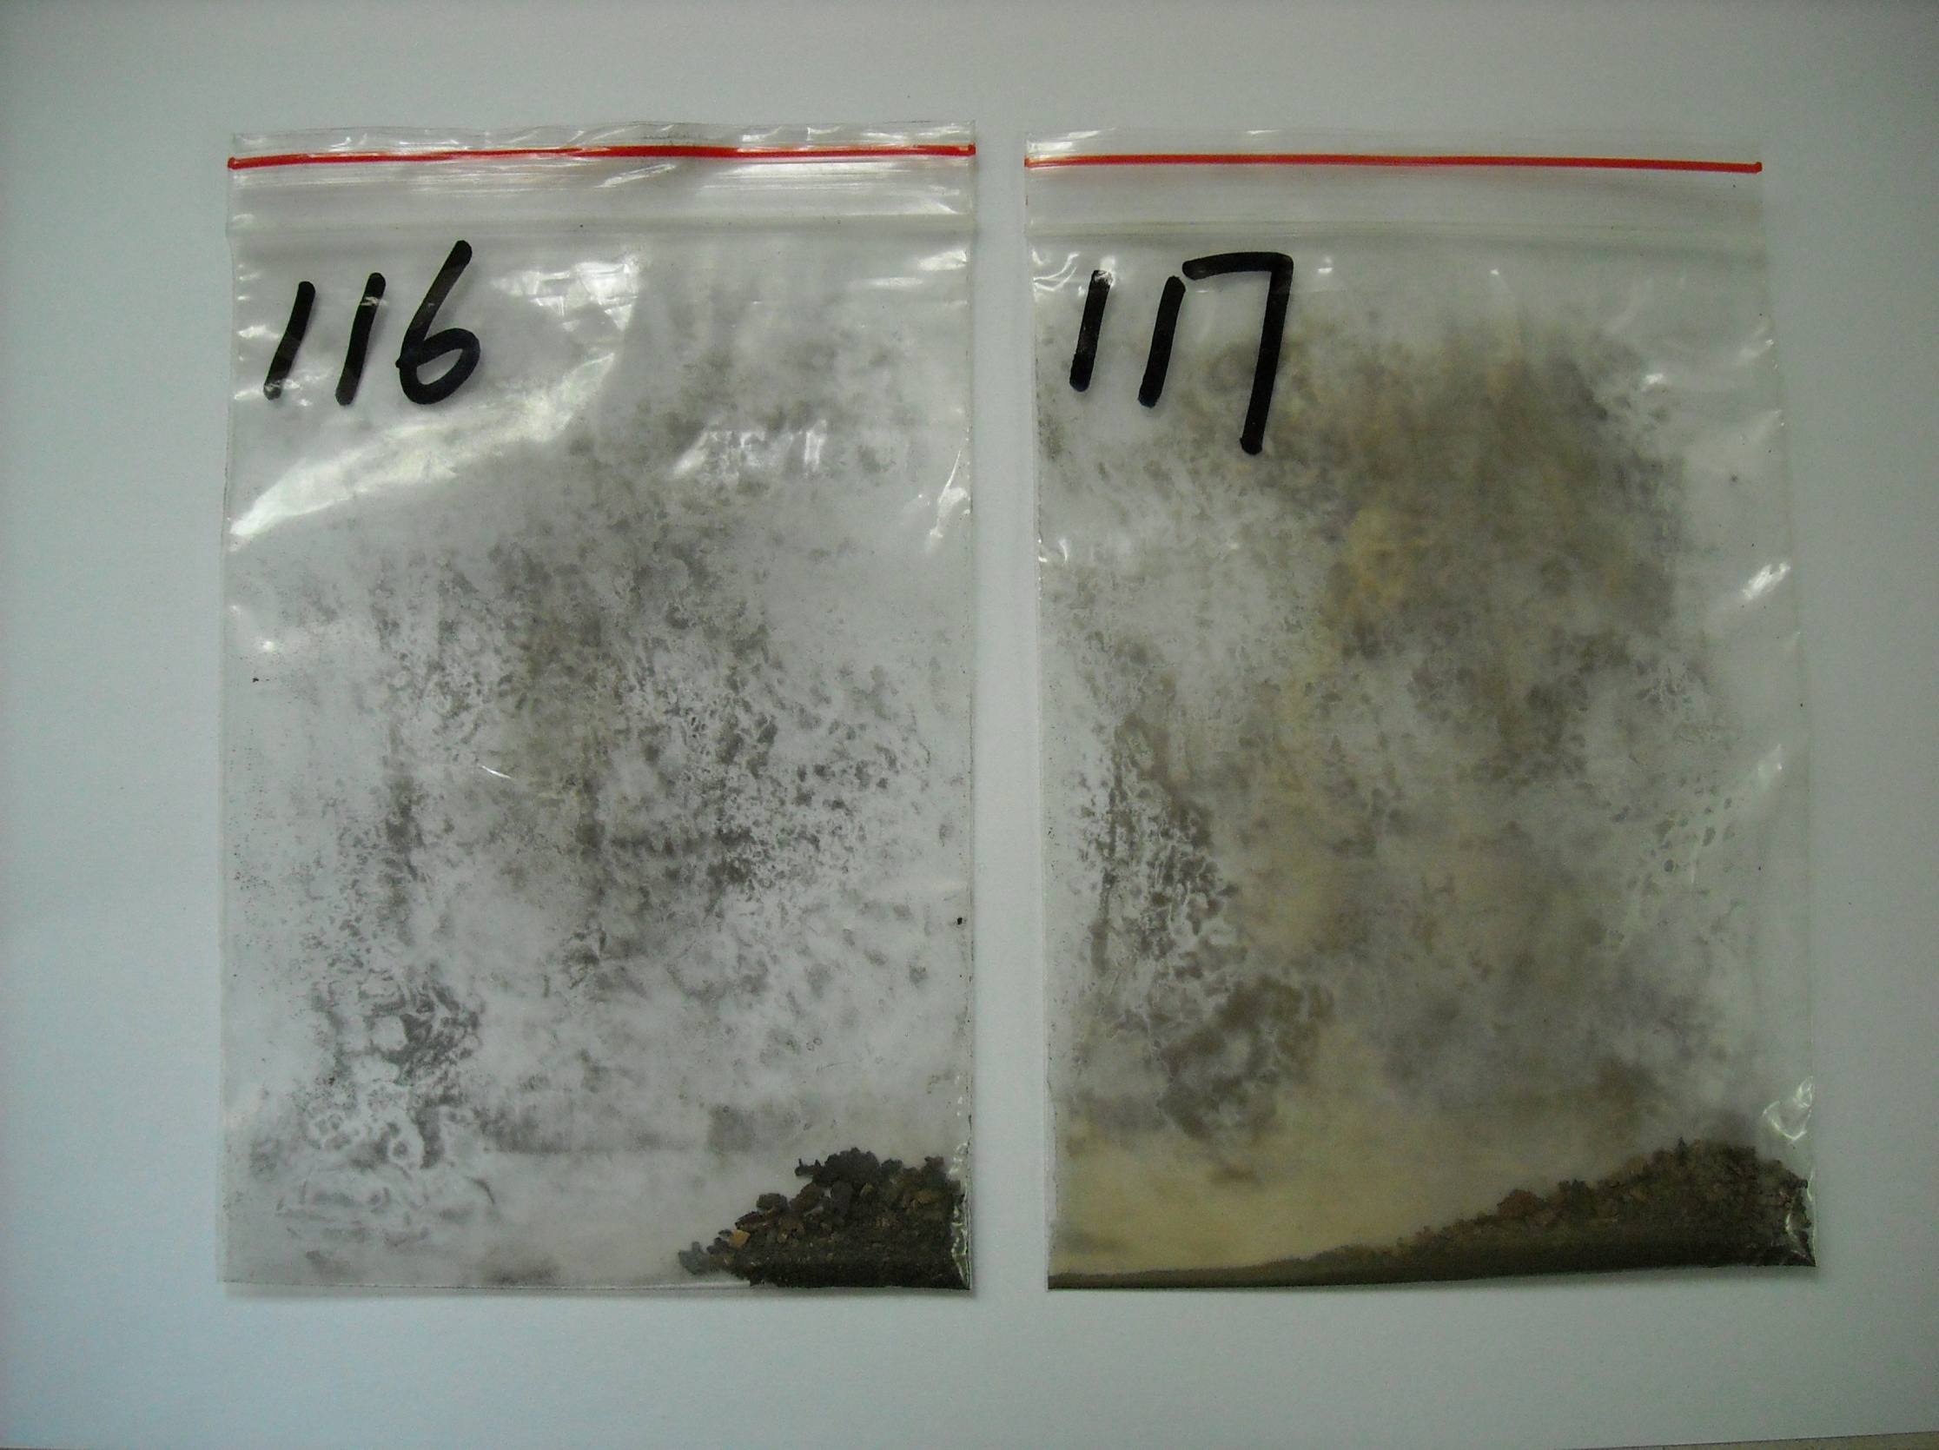
Experimental conditions and results of shock induced phase transition

Slide 28
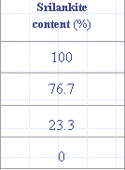
XRD analysis
Unshocked MC-150 TiO₂ (a), shocked MC-150 TiO₂ at 2.56 km/s (b)
shocked MC-150(10%)+Cu at 2.73 km/s (c), 3.07 km/s (d)，3.37 km/s (c)

Slide 29
Synthesis of high-pressure phase of TiO2（T2)
XRD patterns of shock-recovered samples shocked Cu+ T2(20 %),a-b,at 3.37km/s

Slide 30
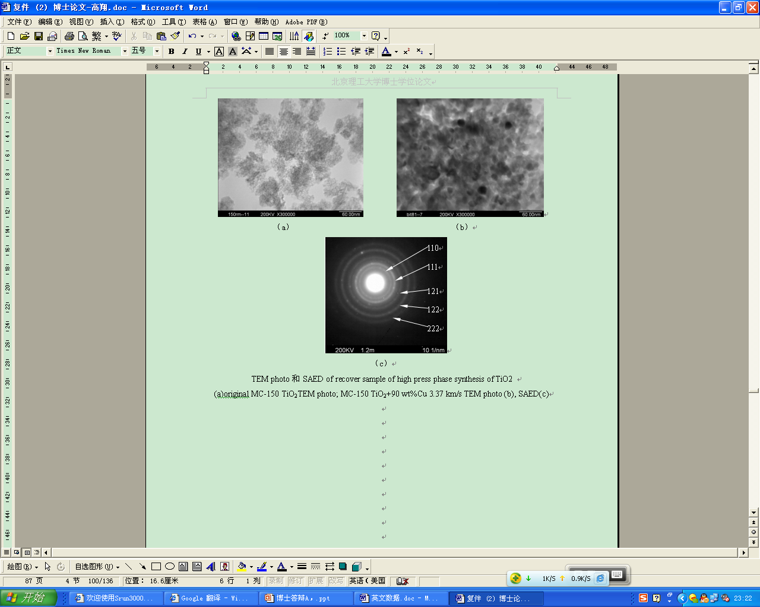
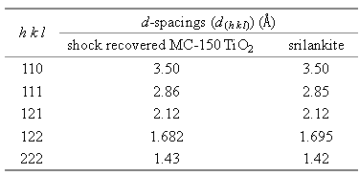

Slide 31
UV-vis Spectra of Srilankite TiO2
Raman Spectra of Srilankite TiO2

Slide 32
Thermal stability
TG-DSC
XRD at elevated temperatures
300℃(a),400℃(b),500℃(c),600℃(d),700℃(e),800℃(f),900℃(g),1000℃(h),1100℃(i)

Slide 33
Content
1
Introduction
2
Shock induced doping of TiO2
3
Shock synthesis of high pressure phase of TiO2
4
Photoresponse properties of shock treated TiO2

Slide 34
Photocatalytic evaluation of N-doped TiO2 and high pressure phase TiO2
Schematic of photocatalytic degradation
Xenon lamp; 2. Rubber stopper; 3. Reactor; 4.Water and photocatalyst;
5. Stirrer; 6. dark box

Slide 35
Photocatalytic degradation of rhodamine B using N-doped TiO2
(Moderate shock intensity is preferred)
P25 TiO2+10wt%C2N4H4 1.2 km/s(a), 2.52 km/s(b), 2.25 km/s(c), 1.90 km/s(d ),
1.79 km/s(h);(e) P25 TiO2+5wt%C2N4H4 2.25 km/s;
(f) P25 TiO2+1wt%C2N4H4 2.25 km/s; (g) P25 TiO2 2.25 km/s

Slide 36
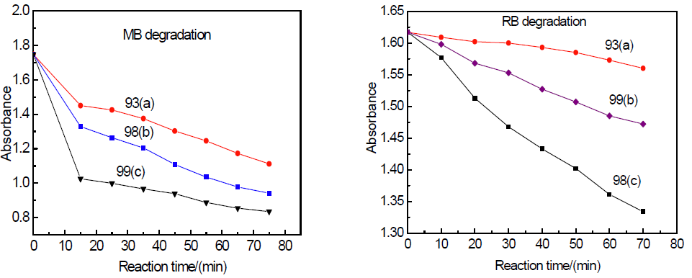
Photocatalytic degradation of
different samples to methylene blue (MB)
(a)P25+C2N4H4(10%) at 2.25km/s;
(b)H2TiO3+ C2N4H4(10%) at 2.74km/s;
(c)H2TiO3+ C2N4H4(10%) at 2.25km/s.
Photocatalytic degradation of
different samples to Rhodmine B (RB)
(a)P25+C2N4H4(10%) at 2.25km/s;
(b)H2TiO3+ C2N4H4(10%) at 2.25km/s;
(c)H2TiO3+ C2N4H4(10%) at 2.74km/s.

Slide 37
Photocatalytic Degradation of Methylene blue using high-pressure phase TiO2
(a) MC-150TiO₂+90wt%Cu 3.07 km/s; (b) MC-150 TiO₂+90wt%Cu 3.37 km/s

Slide 38
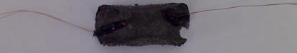
Photo electrochemical activity of TiO2 after shock processing
Powder sample and Graphene
I-V

Slide 39
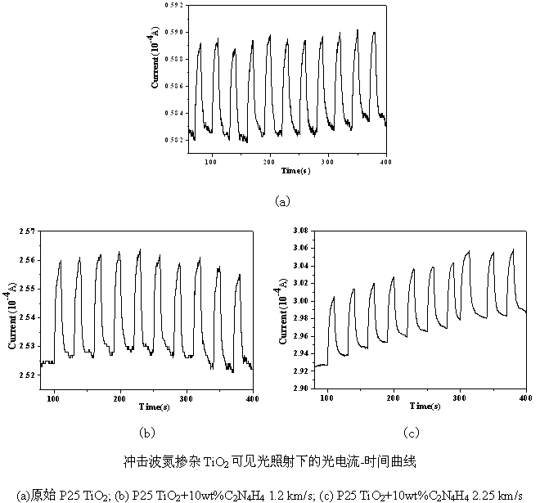
Photo electrochemical activity of N-doped TiO2
0.008 10⁻⁴A
5times
10times
0.04 10⁻⁴A
0.08 10⁻⁴A
Photo electrochemical activity of N-doped TiO2 under visible light irradiation
(a) Raw TiO2; (b) shock treatment at 1.2km/s; (c) shock treatment at 2.25km/s

Slide 40
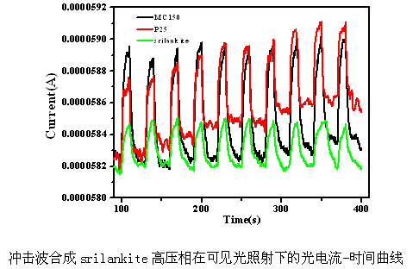
Photo electrochemical activity of high-pressure phase of TiO2
Good stability

Slide 41
DSSC performance of shock induced N-doped TiO2
Flyer
velocity
(km/s)
Cutoff
wave
length
(nm)
Band-gap
width
(ev)
N-doped
concentr
ation(at%)
Anatase
phase
content
(%)
Rutile
phase
content
(%)
Srilankite
phase
content
(%)
sample
a/b/c
1.20
450
2.76
0.76
71.4
11.8
16.8
a
b
c
Sample
Sample preparation
Isc(mA/cm2)
Voc(mV)
ff(%)
n(%)
a
Smear two layer and sinter
3.20
738
0.71
1.66
Smear one layer and sinter
Smear one layer and sinter
b
5.00
725
0.76
2.66
c
Smear one layer and sinter
Smear two layer and sinter
7.30
753
0.75
4.17

Slide 42
Conclusions
Nitrogen doped TiO2 was obtained by shock treatment of a mixture of TiO2 precursor and nitrogen resources. Nitrogen doped TiO2 exhibits enhanced visible-light photocatalytic activity.
Pure Srilankite TiO2 can be obtained by shock-induced phase transition;
Shock-induced doping might be a promising method for powder modification.

Slide 43
Thank you for your attention! http://shock.bit.edu.cn
E-mail: pwchen@bit.edu.cn

