Slide 1
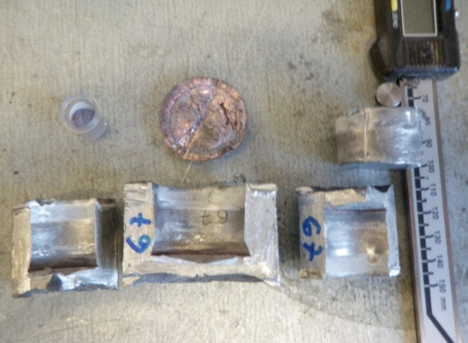
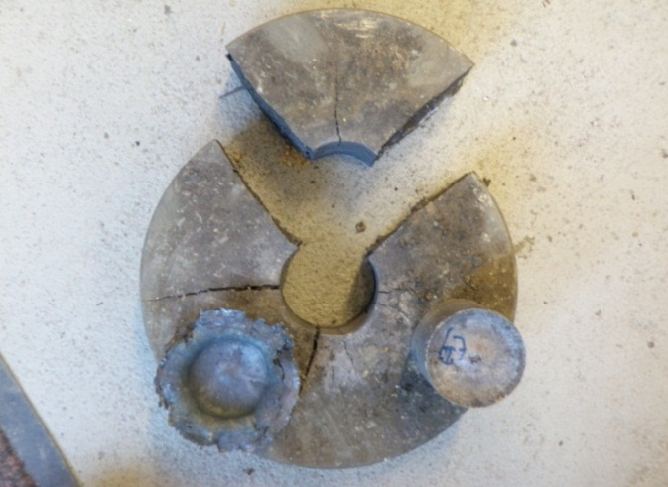
The new subterranean shock-wave laboratory at the
TU Bergakademie Freiberg/ Saxony
T. Schlothauer^{[1]}, K. Keller^{[1]}, A. Greif^{[1]}, M. R. Schwarz^{[2]}, G. Heide^{[1]}, E. Kroke^{[2]}
^{[1]} Institute for Mineralogy, TU Bergakademie Freiberg
^{[2]} Institute for Inorganic Chemistry, TU Bergakademie Freiberg
TU Bergakademie Freiberg I Akademiestraße 6 I 09596 Freiberg
Phone: 0 37 31/39-0 I Fax: 0 37 31/39-0 I I www.tu-freiberg.de

Slide 2
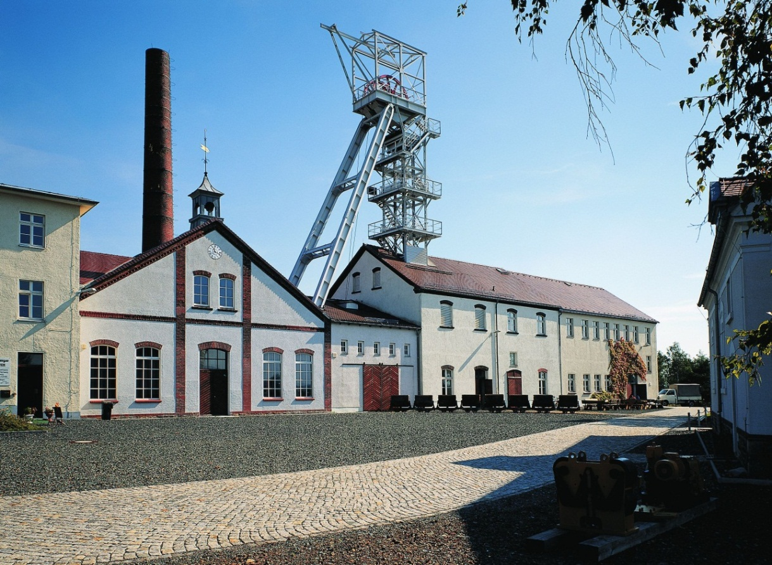
Location in the research and teaching mine
„Reiche Zeche“ Freiberg
est.: October 2007 by the
Dr. Erich-Krüger-Foundation
part of the Freiberg High
pressure Research Center
(FHP)
ca. 150m below surface
safe storage of explosives
possibility of contemporary work (6 experiments per hr. (excluded the pre-paration and recovery time)
After complete installation →
20 kg charge mass are possible
Source: W. Rabich, TU Bergakademie Freiberg
1

Slide 3
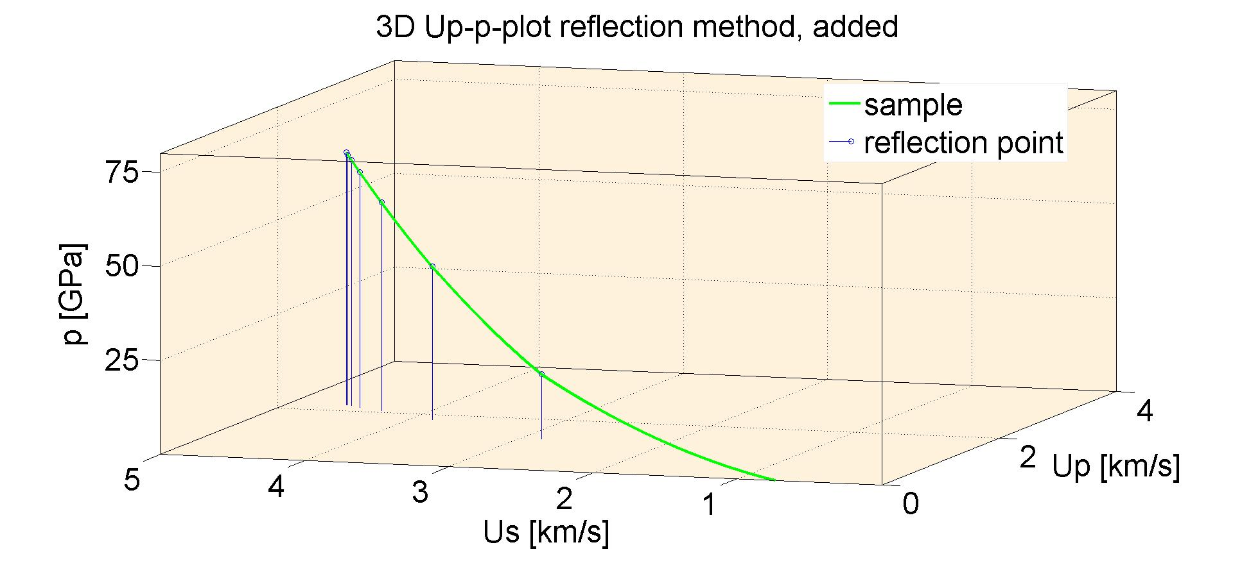
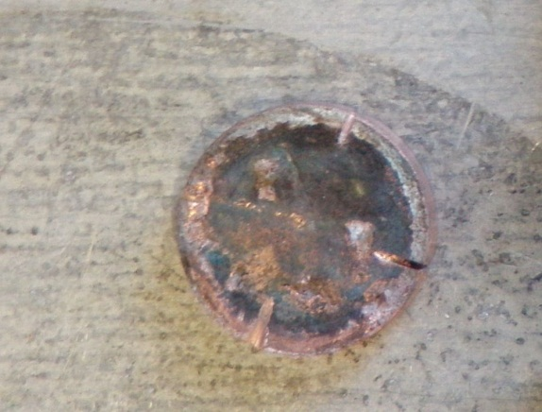
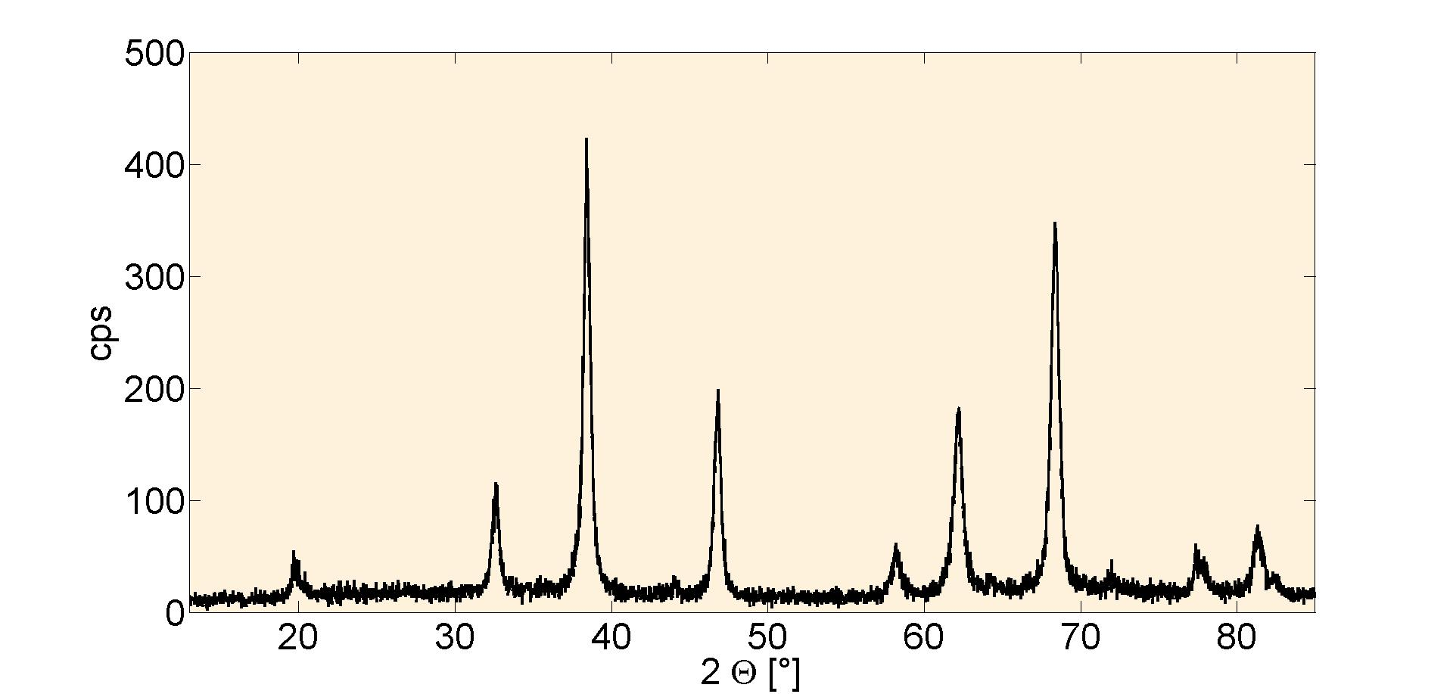
Three main goals:
1. Calculation of the p-, T- and t-
conditions
2. 100% sample recovery
3. 100% phase transition
2

Slide 4
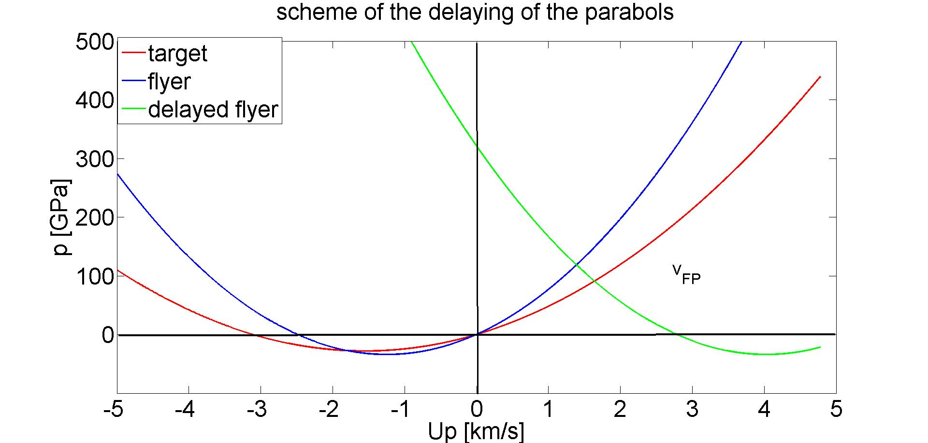
1. Calculations
from
$$p=ρU_{p}U_{s}$$
with
$$U_{s}=A+BU_{p}$$
follows
$$p=ρ_{0}U_{P}A+ρ_{0}U_{P}^{2}B$$
Reducing of the Hugoniot-EoS to intersection operations
with a MatLabTM - code
3

Slide 5
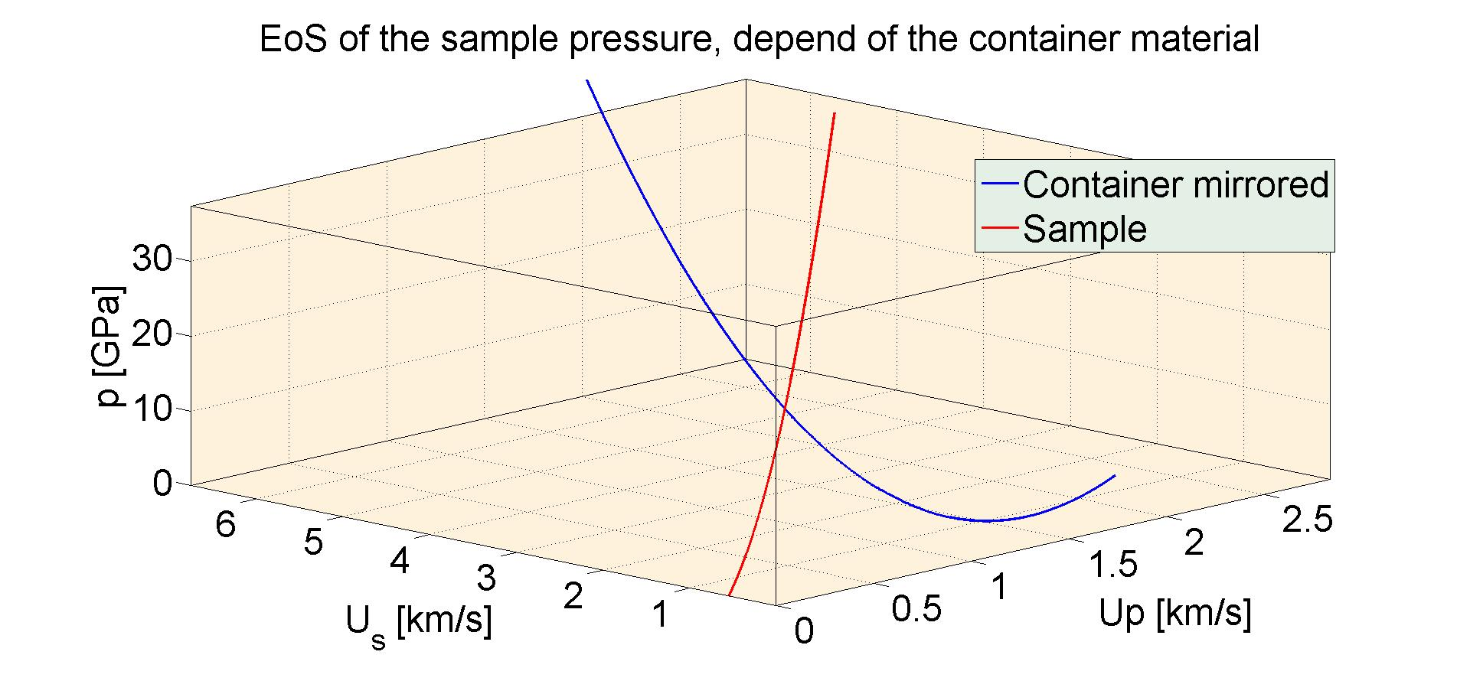
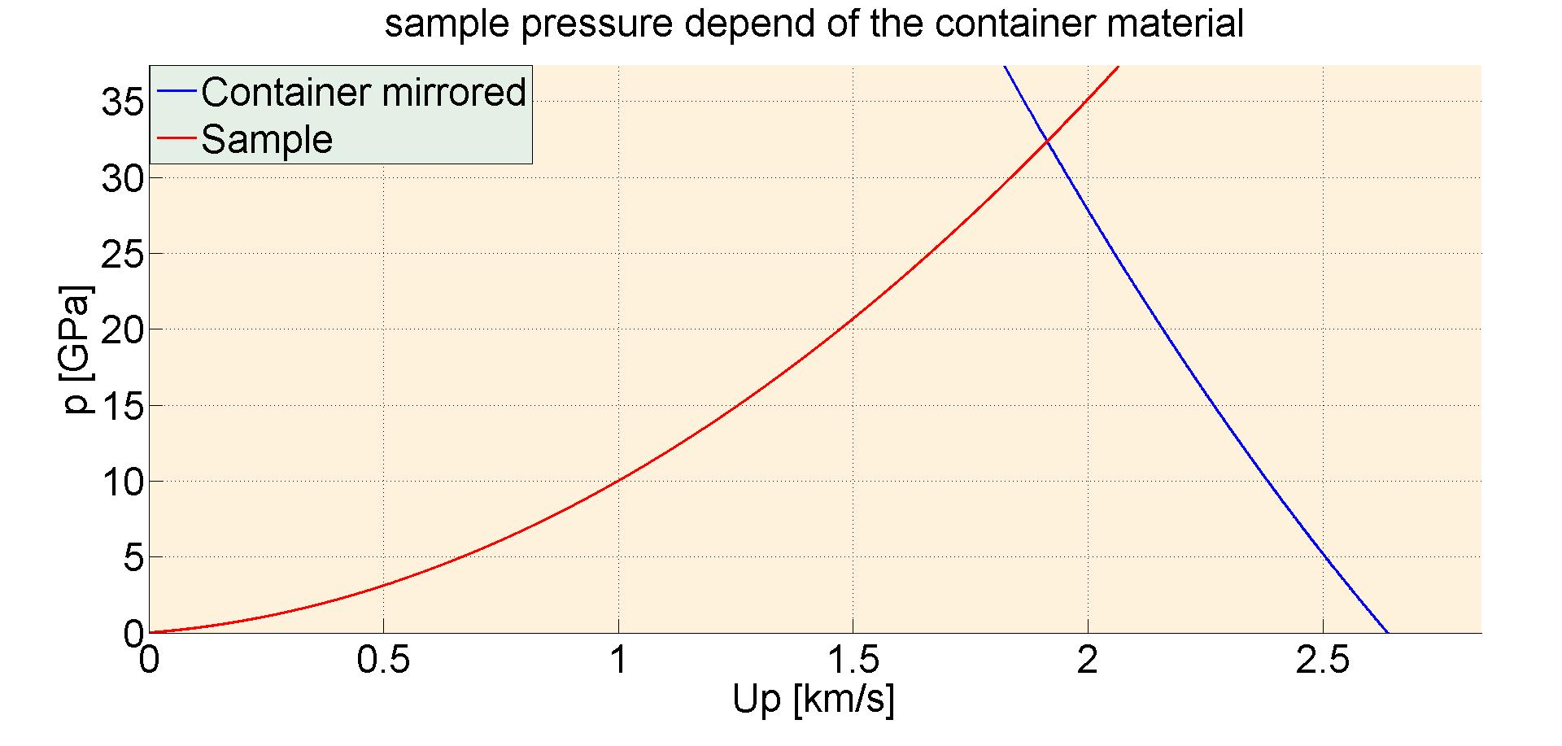
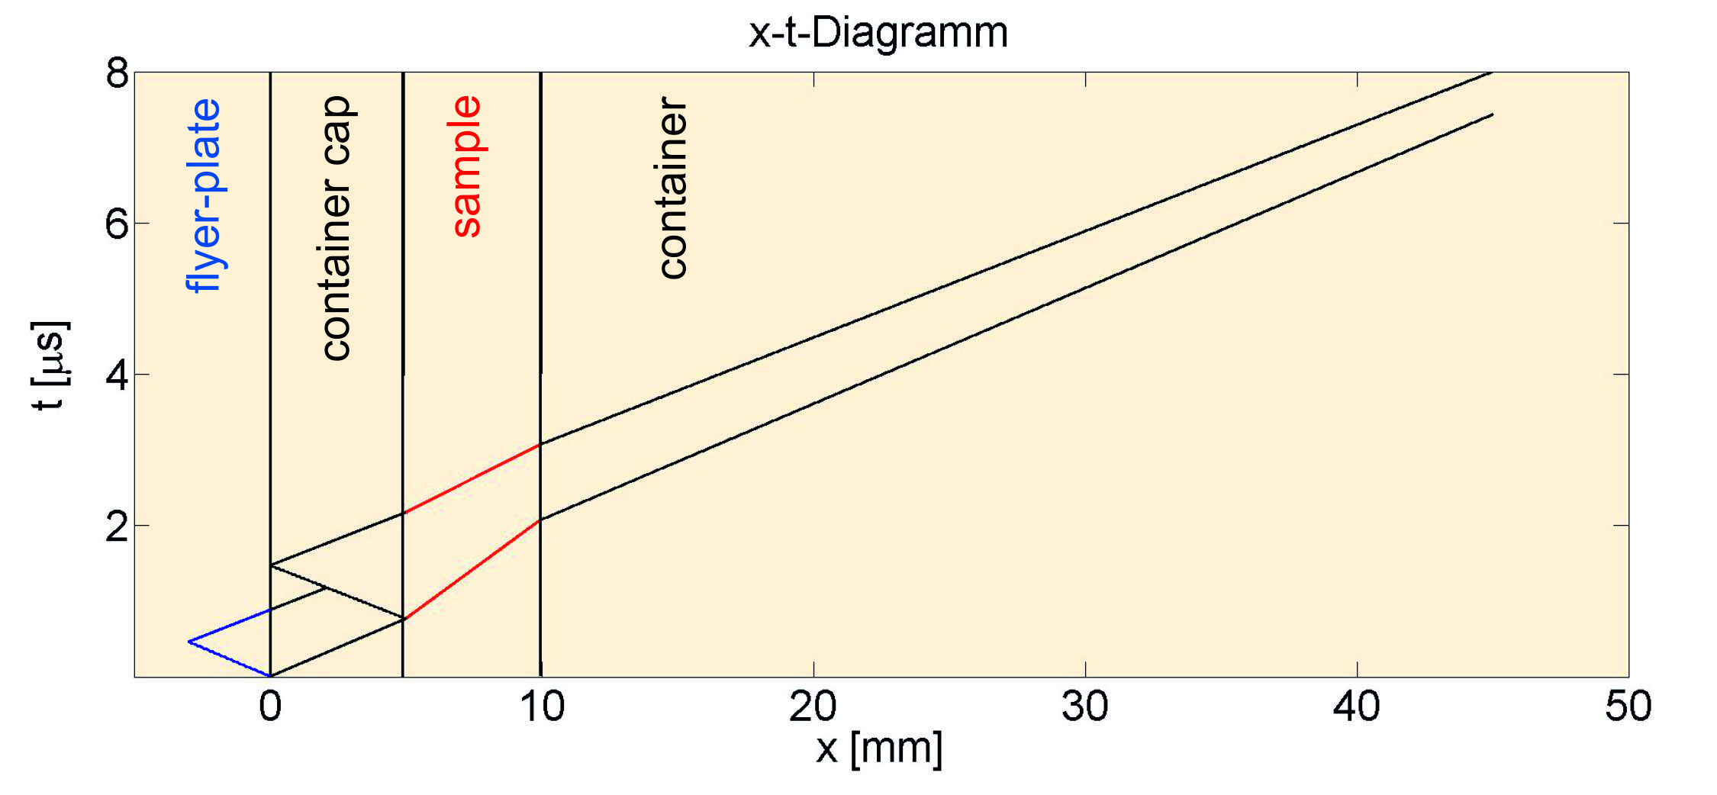
1. Calculations
Results of the MatLab - calculation
p [GPa] | 30,8
T_{schock} [K] | 3756
t [μs] (top) | 1,53
t [μs] (bottom) | 1,11
4

Slide 6
Boundary conditions
For the shock - wave laboratory the following boundary conditions
are setted:
M >1 (Us>C_{B})
p > HEL
p < p_{melt(Hugoniot)}
$1<k<1+ \frac{2}{γ_{SR}}$ „Grüneisen – boundary“ of the porosity
p_{max} > B₀ „weak“ shock – waves
metal : precursor - ratio > 9:1 for the impedance method
linear Hugoniot - relation: Us=A+B*Up
instead the release adiabat the mirrored Hugoniot is usable
important temperature is T_{schock} instead of T_{release}
For the reflection – method must be fullfilled: Z_{container} > Z_{sample}
5

Slide 7
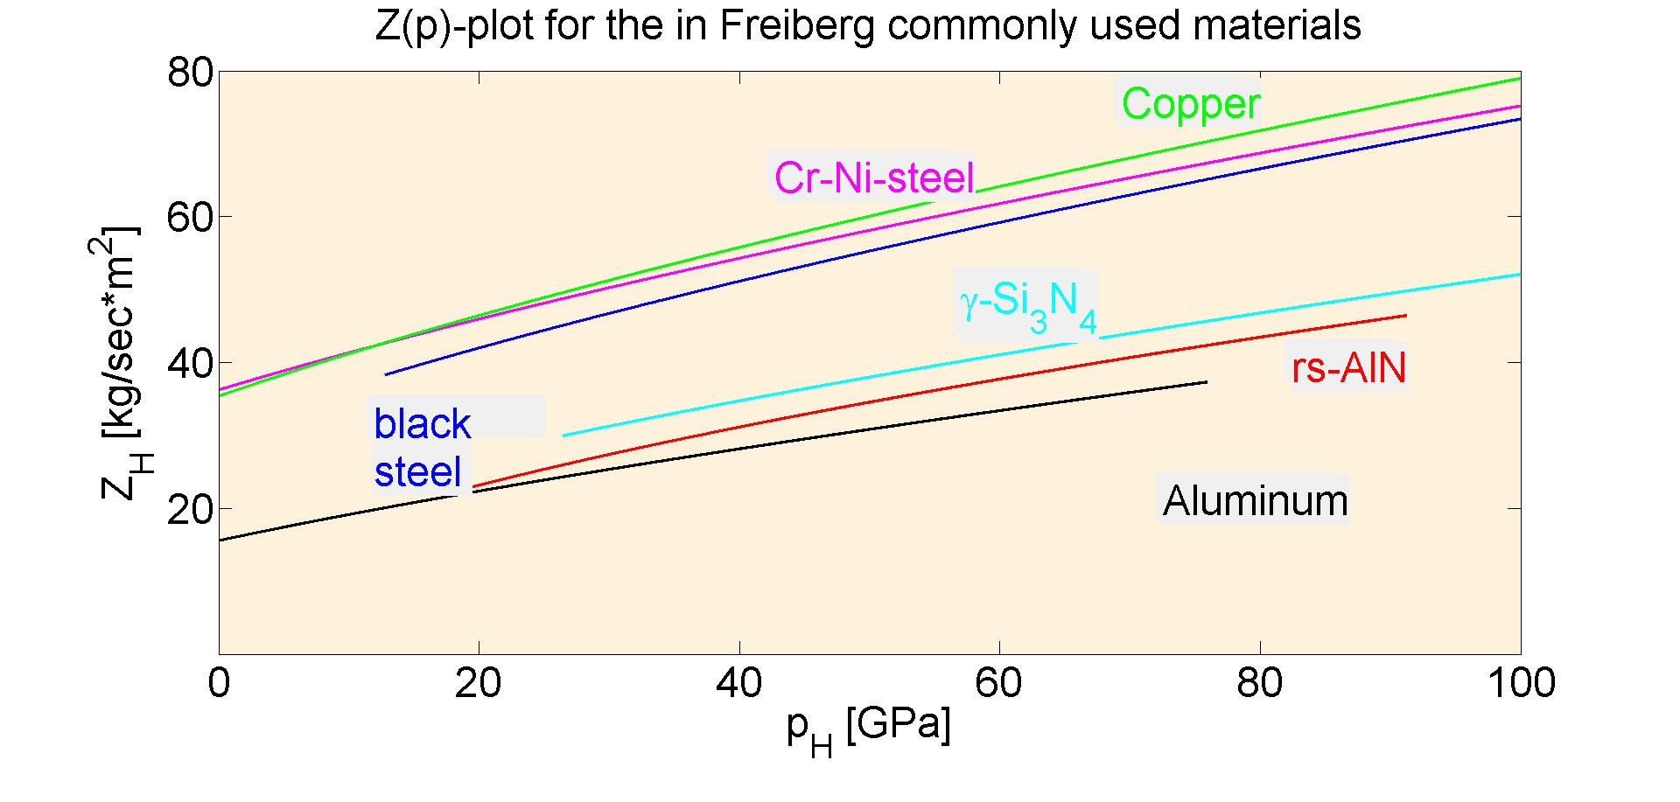
2. Sample recovery
The impedance-function along the Hugoniot[*] with
$$Z_{H}=ρ_{H}∗ {Us}_{H}$$
gives:
EoS – source: http://teos.ficp.ac.ru/rusbank/
6

Slide 8
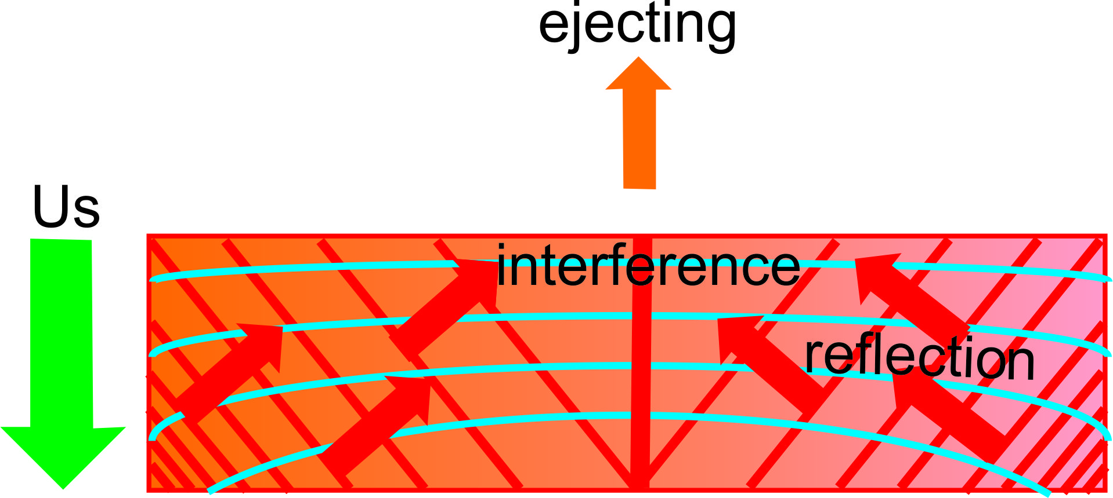
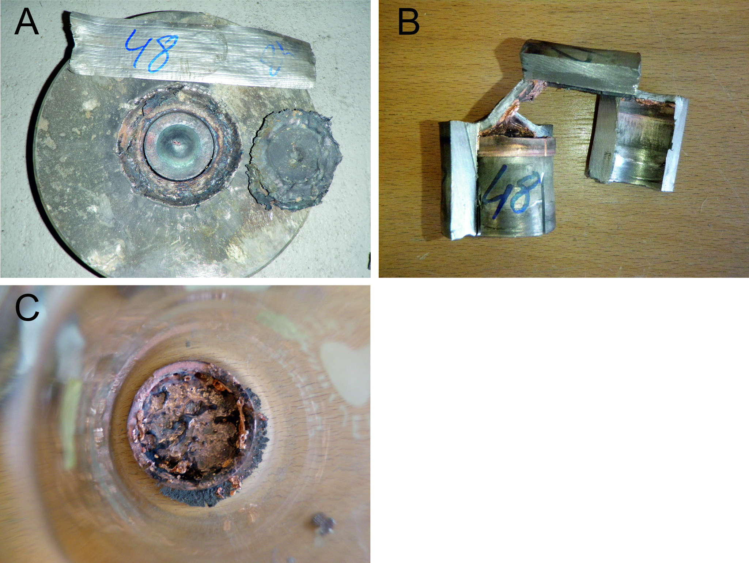
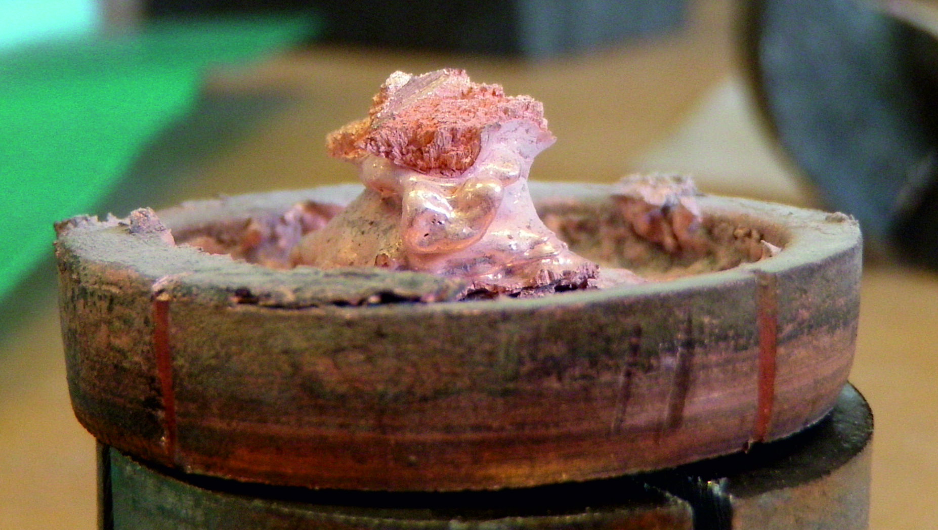
2. Sample recovery
density gradient as result of
the static compaction
Blow-out of the sample and complete
melting of the copper powder
upstreaming jetting
7

Slide 9
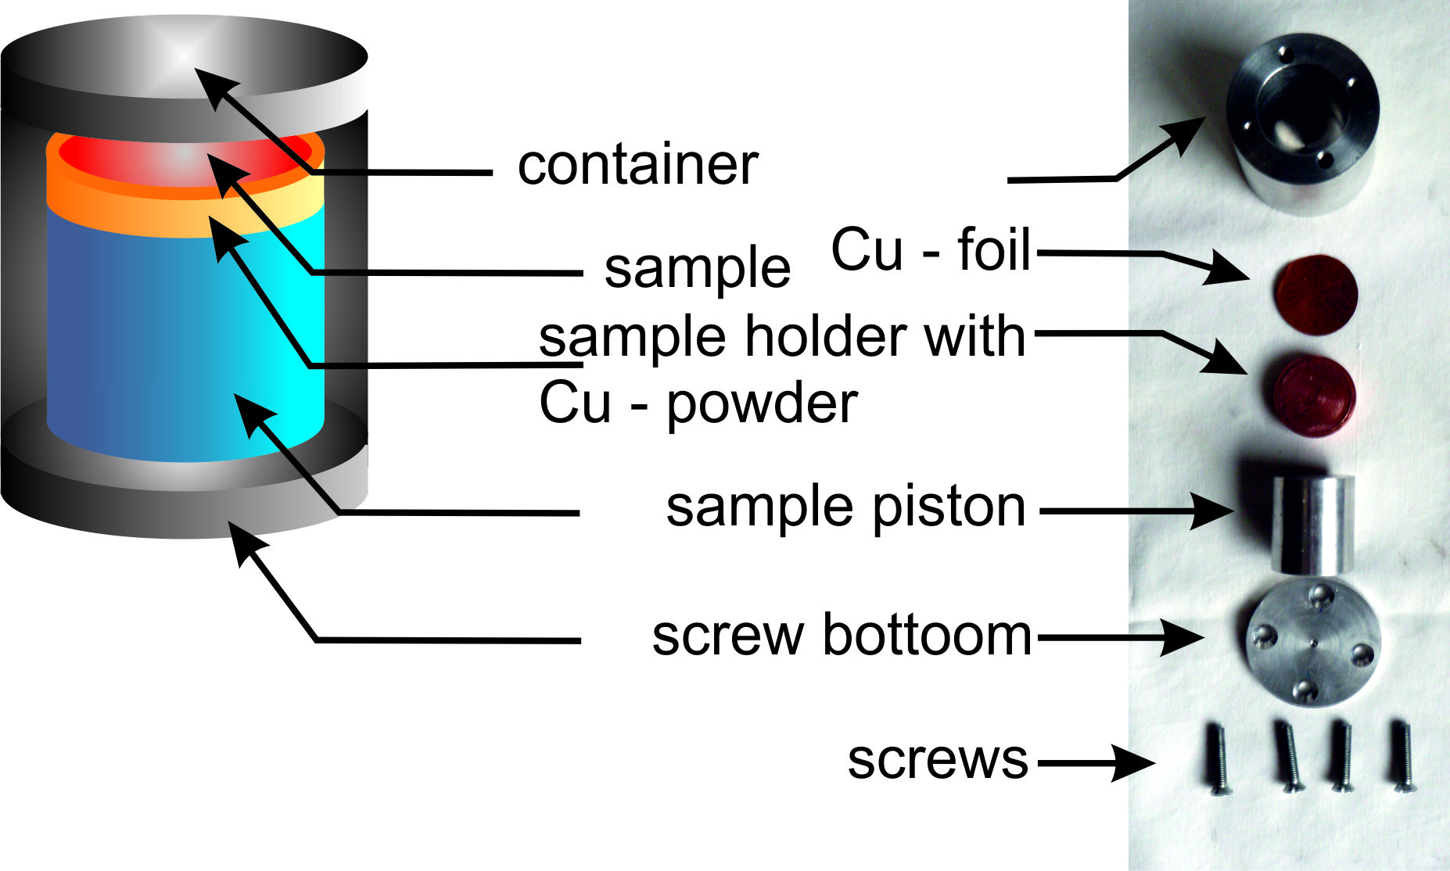
2. Sample recovery
The material with the lowest impedance
(black steel) is located in the
center of the recovery capsule
avoiding of shock wave
reflections through sample
and container cap
Stepwise compaction of the Cu –
powder + sample mixture (3 times
per 5mm)
avoiding of Mach – effects and
upstreaming jetting
8

Slide 10
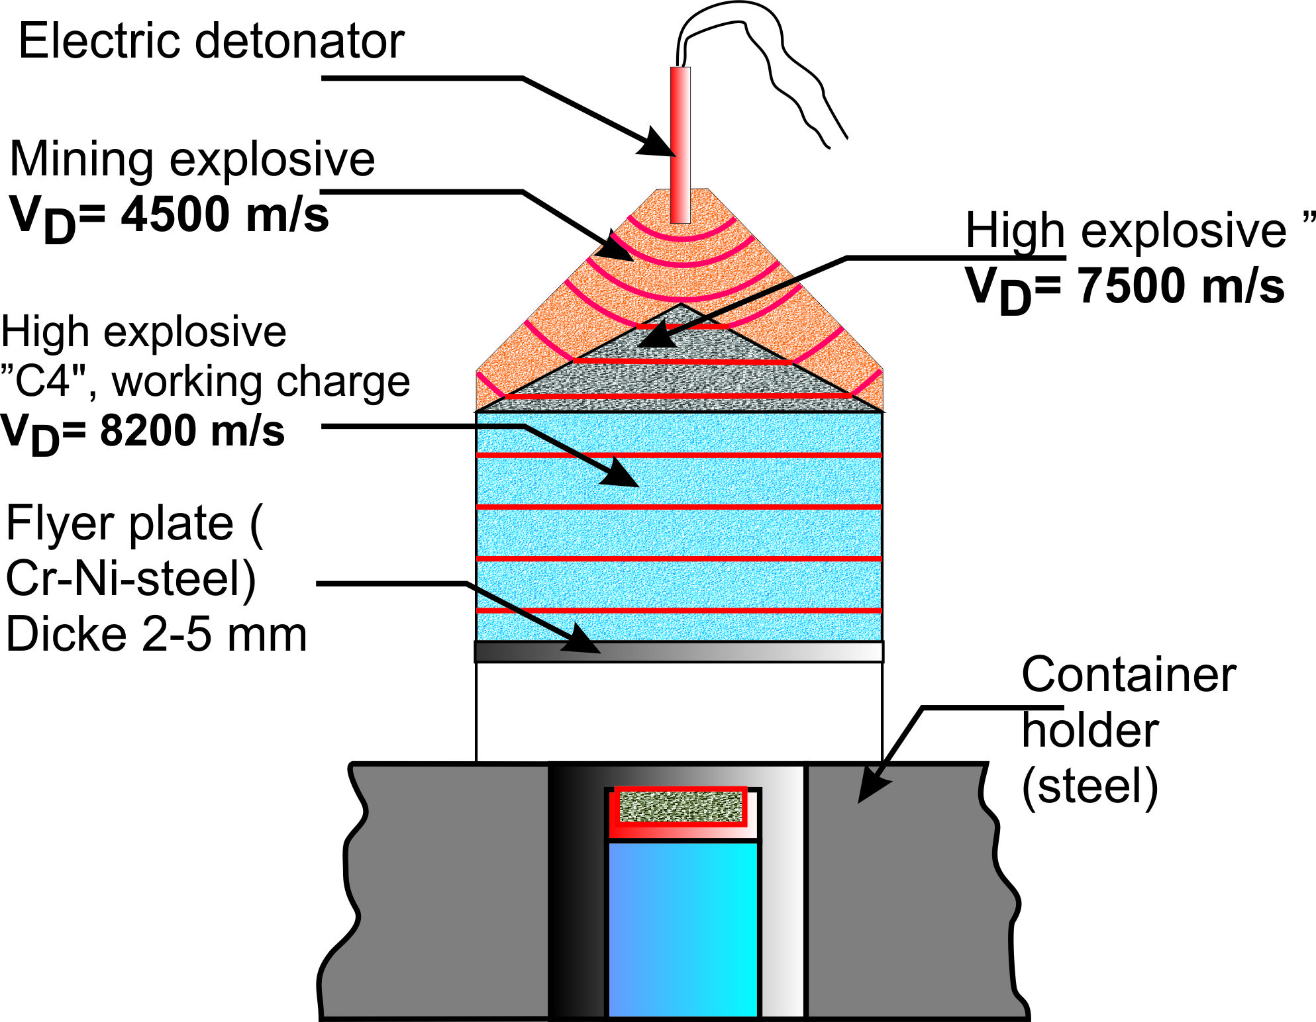
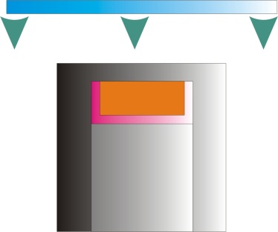
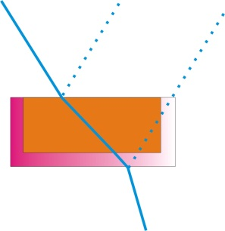
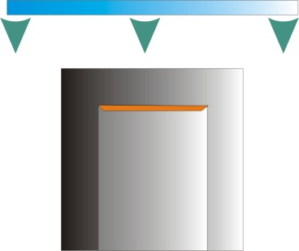
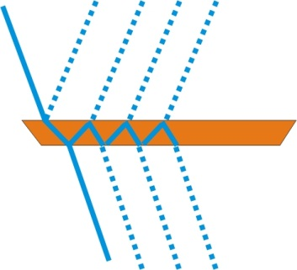
2. Sample recovery
impedance method
reflection method
calculation of the flyer plate
velocity after DeCarli 1981
velocity measurements are possible
9

Slide 11
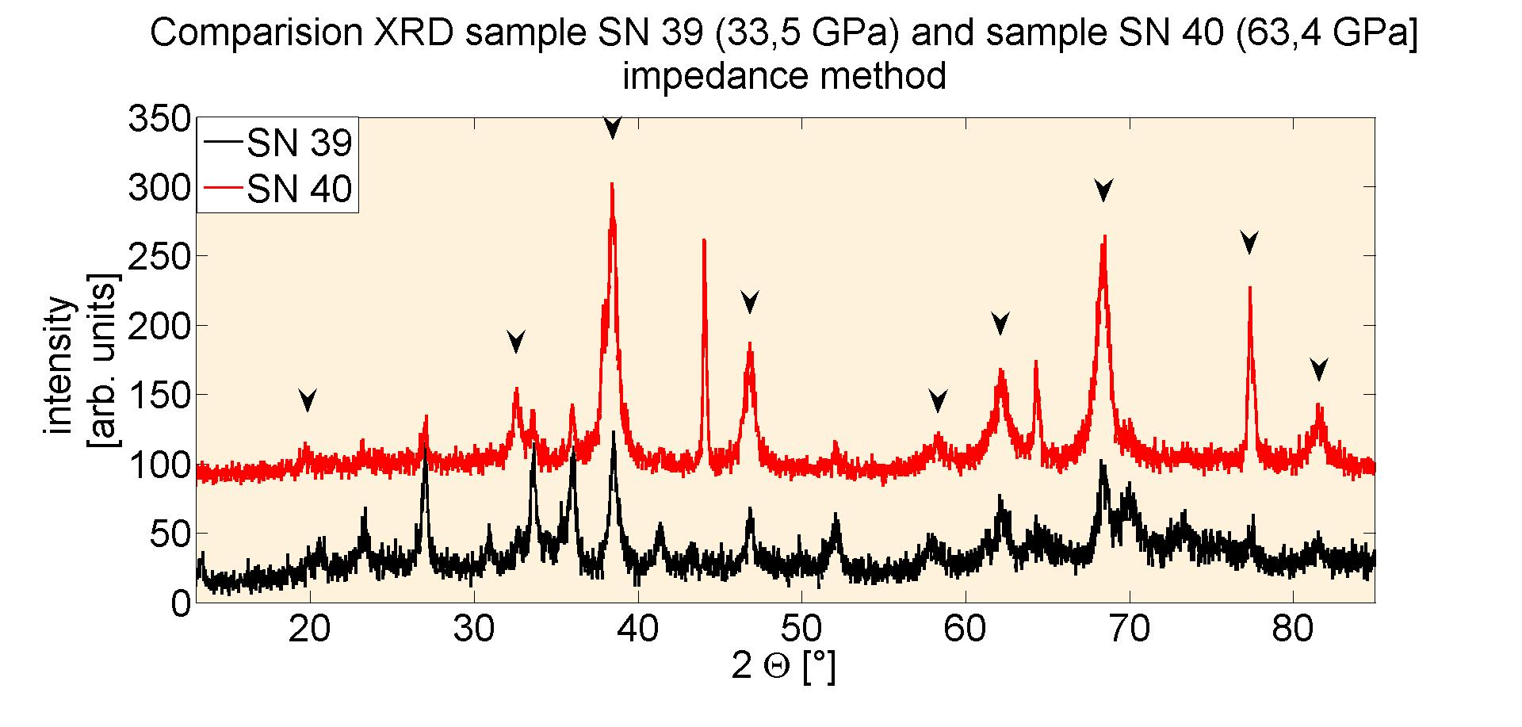
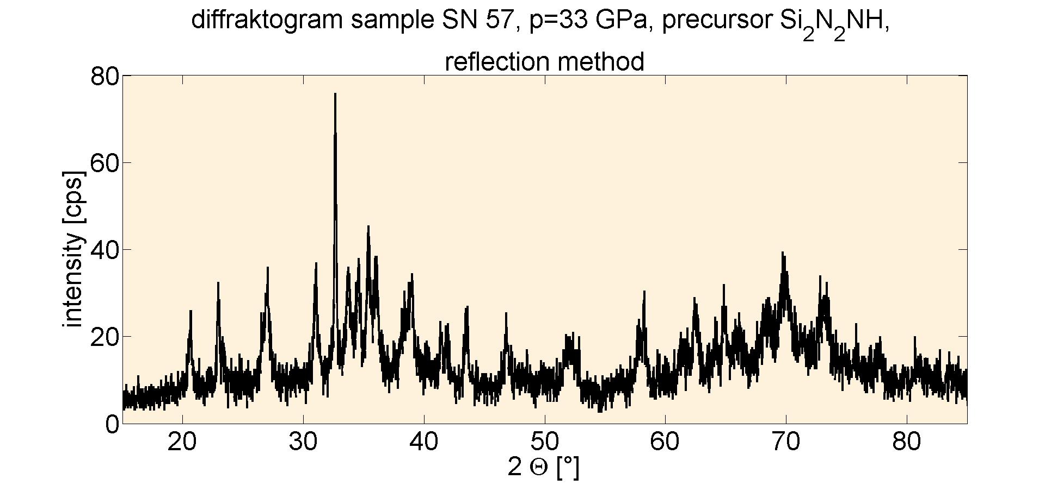
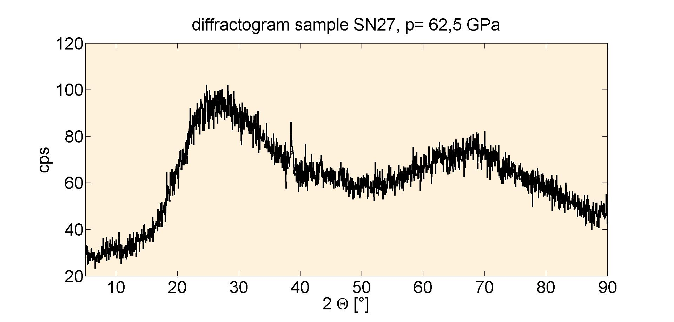
3. Phase transition
precursor β-Si₃N₄
precursor Si₂N₂NH
without complete phase transition
use of crystalline precursors (α -
und β – Si₃N₄ under all achievable
conditions
use of amorphous precursors of
the type Si_{x}N_{y}H_{z} also under elevated
pressures
10

Slide 12
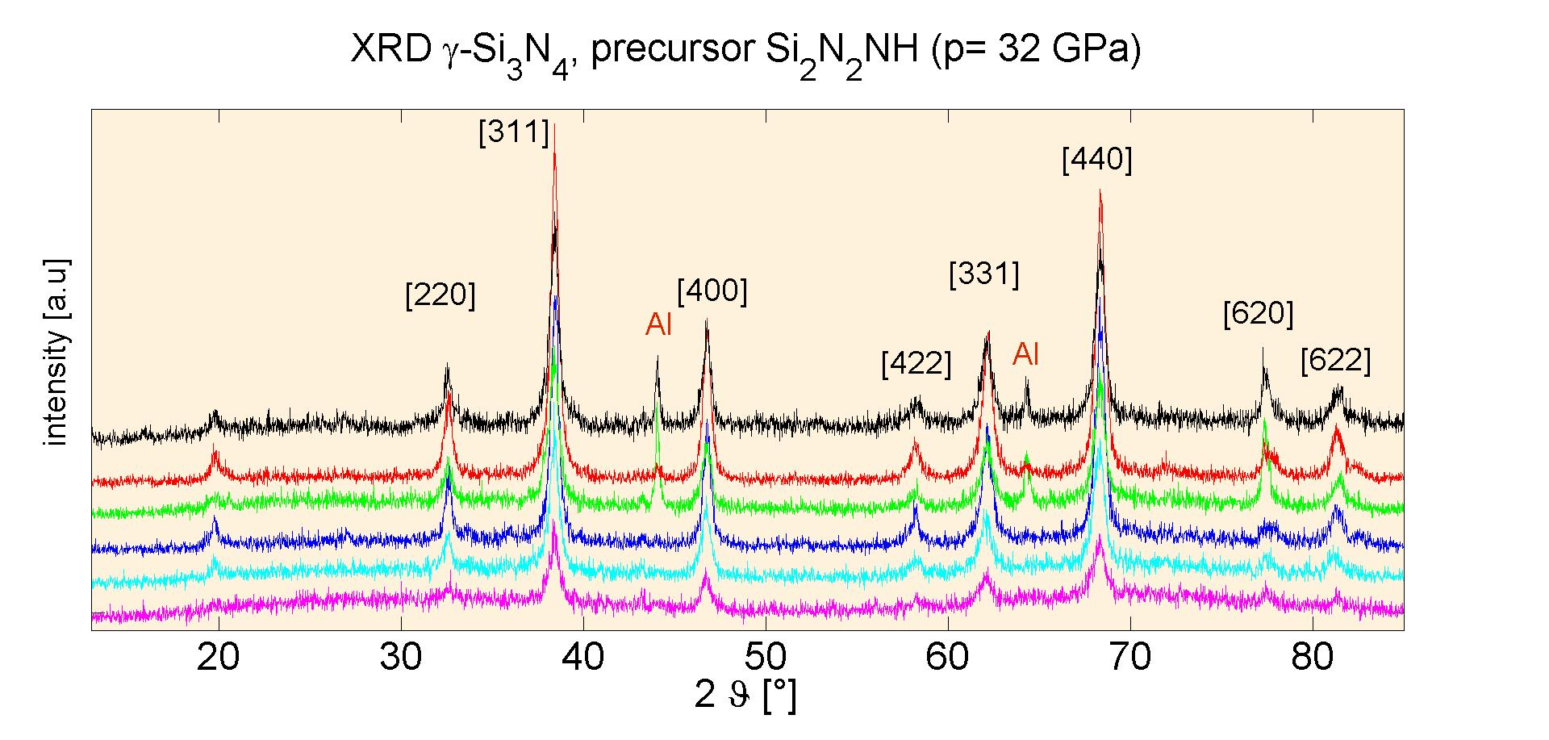
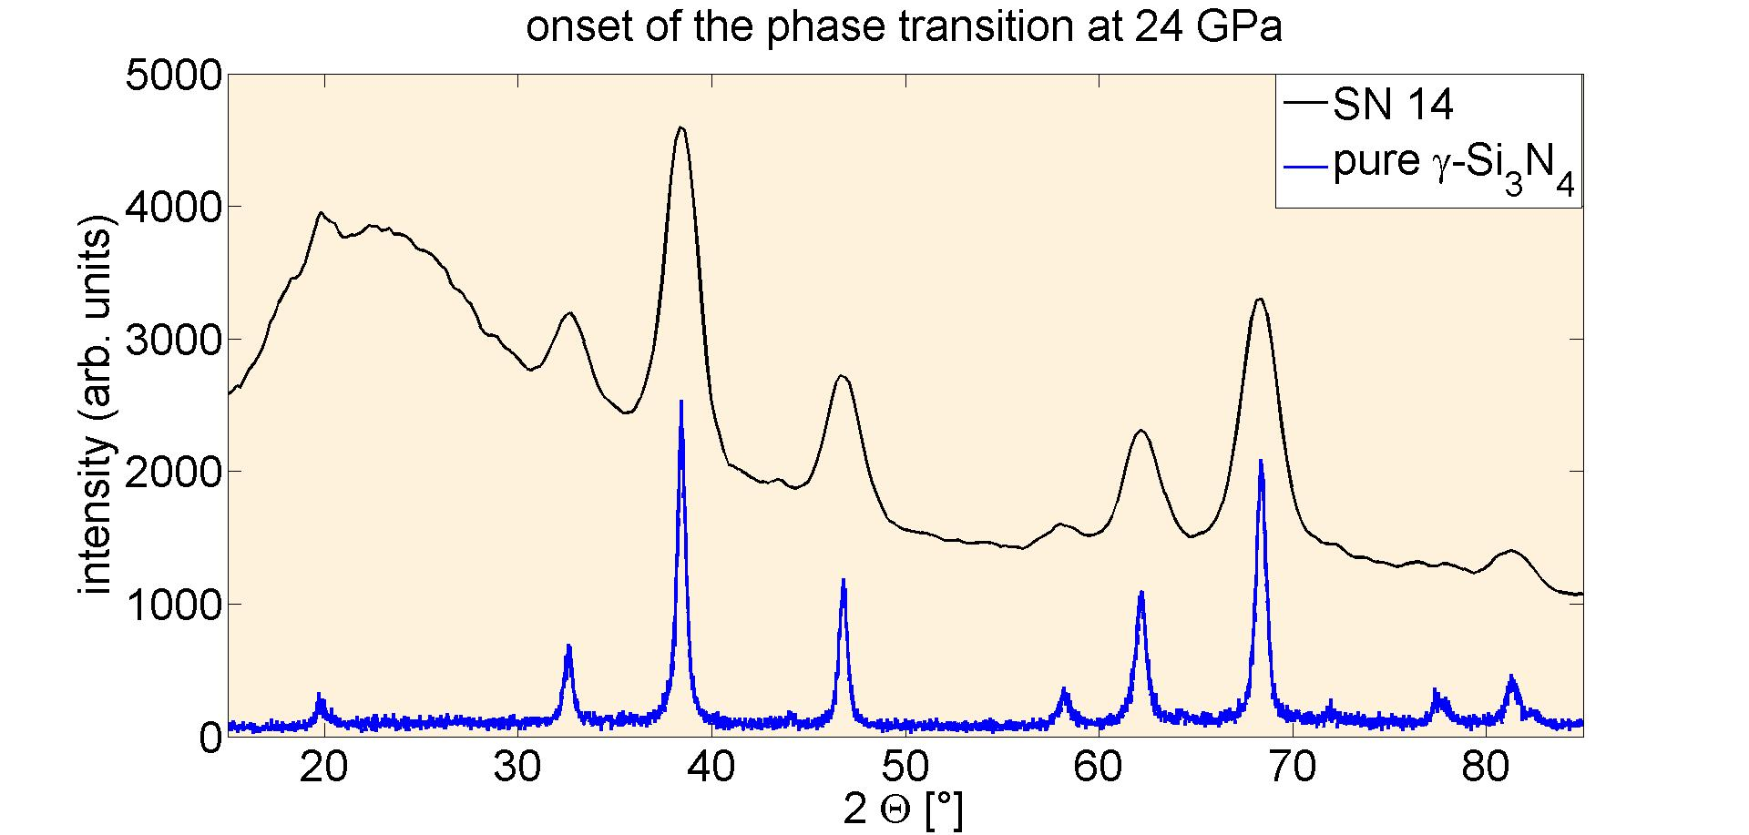
3. Phase transition
complete phase transition possible
under use of amorphous
precursors of the type Si_{x}N_{y}H_{z} under
moderate pressures
only with low porosites possible
(near the Grüneisen-boundary)
HP – HT - synthesis
direct synthesis of the HP – phase
onset of the phase transition at
≈ 24 GPa
also possible with Si(NH)₂
not with the reflection mehod possible
Decay- reaction with:
3 Si₂N₂NH ↔ 2 γ-Si₃N₄+NH₃
11

Slide 13
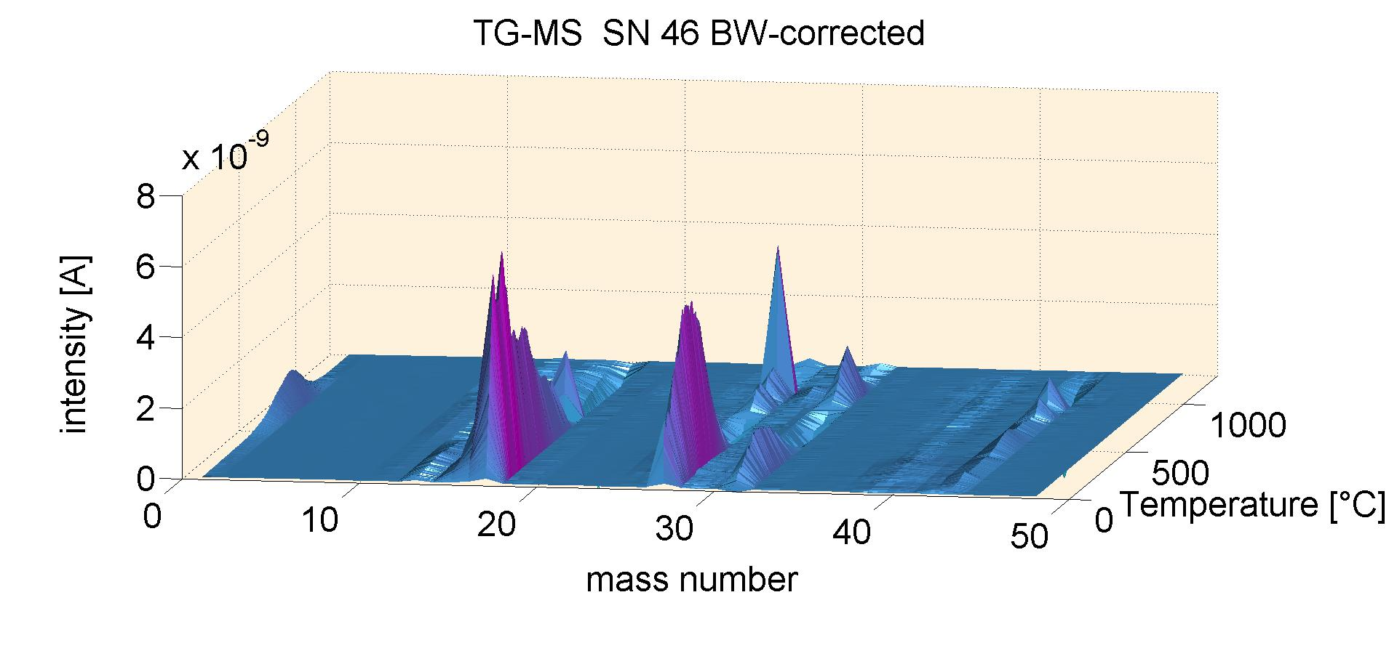
New analytical possibilities
result of the experiments:
pure high pressure phases with different chemical composition
nanostructured materials (grain size 10 – 40 nm)
sample masses up to 2 g up to 1 Mbar
complete mineralogical analytical tool is possible with
mass consumption
12

Slide 14
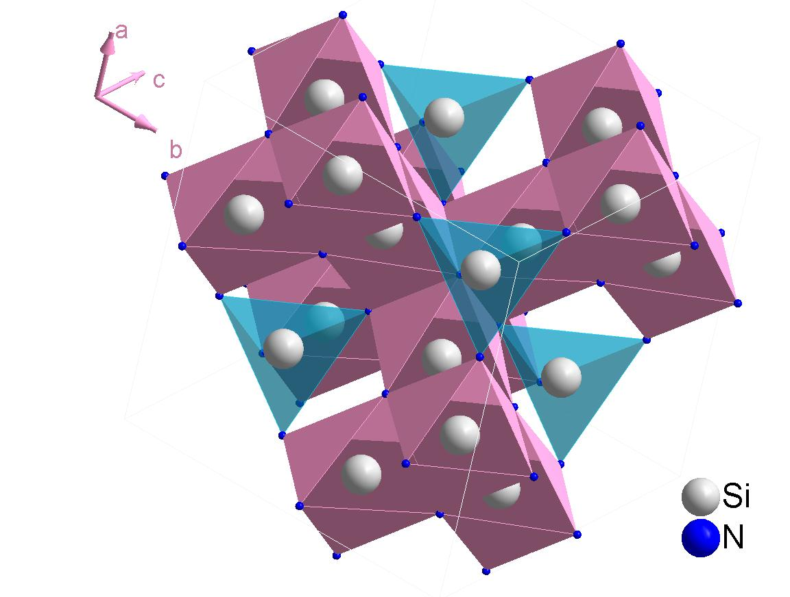
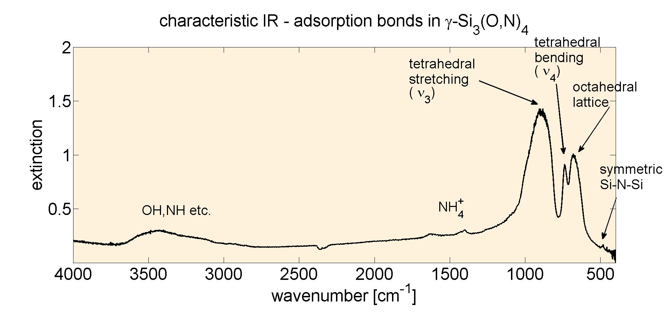
Example: FT – IR on γ – Si₃(O,N)₄
Problems:
sample consumption
strong grain size effects
strong adsorption
nanoscaled samples up to 2 g →
testing of the method and etching
experiments are possible
structure of γ – Si₃(N,O)₄
only a small numbers of vibrations
possible
12

Slide 15
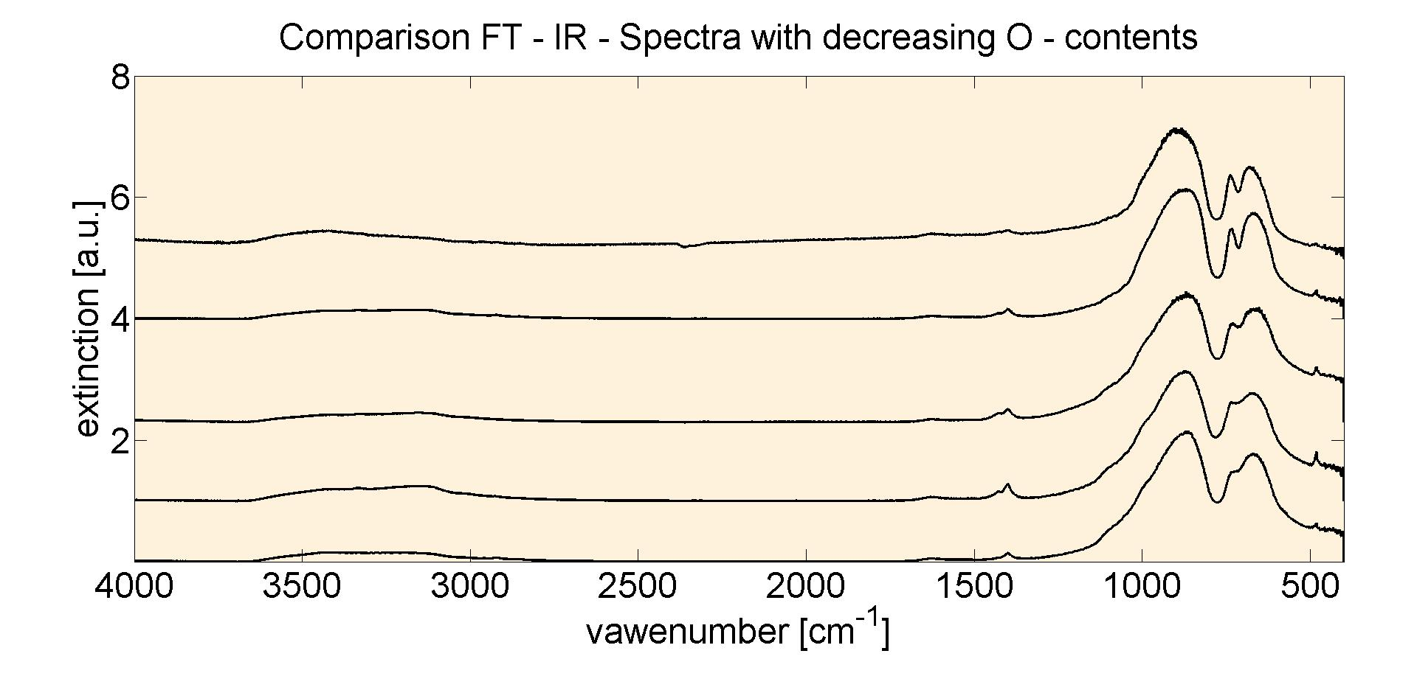
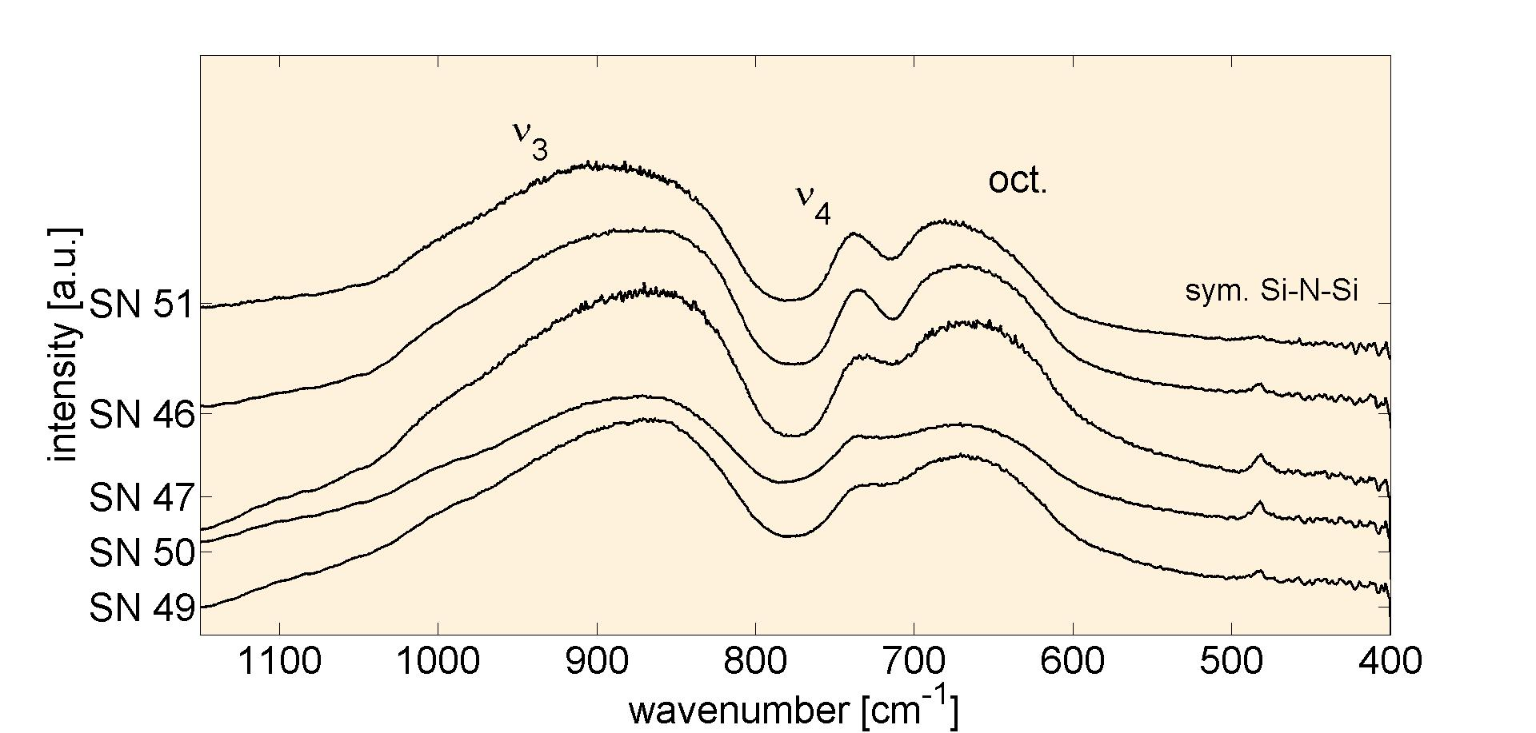
Example: FT – IR on γ – Si₃(O,N)₄
shift of all bands to higher
wave numbers with de-
creasing oxygen contents
determination of oxygen
(wt - %) with qualtitative IR
is possile (also in mixtures
with LP - phases
14

Slide 16
Summary
Sample recovery container optimized for complete recovery with:
material with the lowest impedance in the centre of the recovery capsule
stepwise compaction of the sample powder
under use of the reflection method damping of the reflected SW with
different plate thicknesses
sample masses up to 2 g up to 1 Mbar currently possible
Phase transition optimized with:
use of amorphous H – bearing precursors synthesized especially for
HP – experiments
medium pressure – high temperature synthesis
direct and complete phase transition
Analysis
Synthesis of pure high – pressure phases permits the structural analysis
extremely (especially FT – IR, ²⁹Si MAS-NMR, TG – MS)
Higher sample masses (up to 2 g at 0.86 Mbar) gives new possibilities for
investigations (for examle neutron diffraction)
15

Slide 17
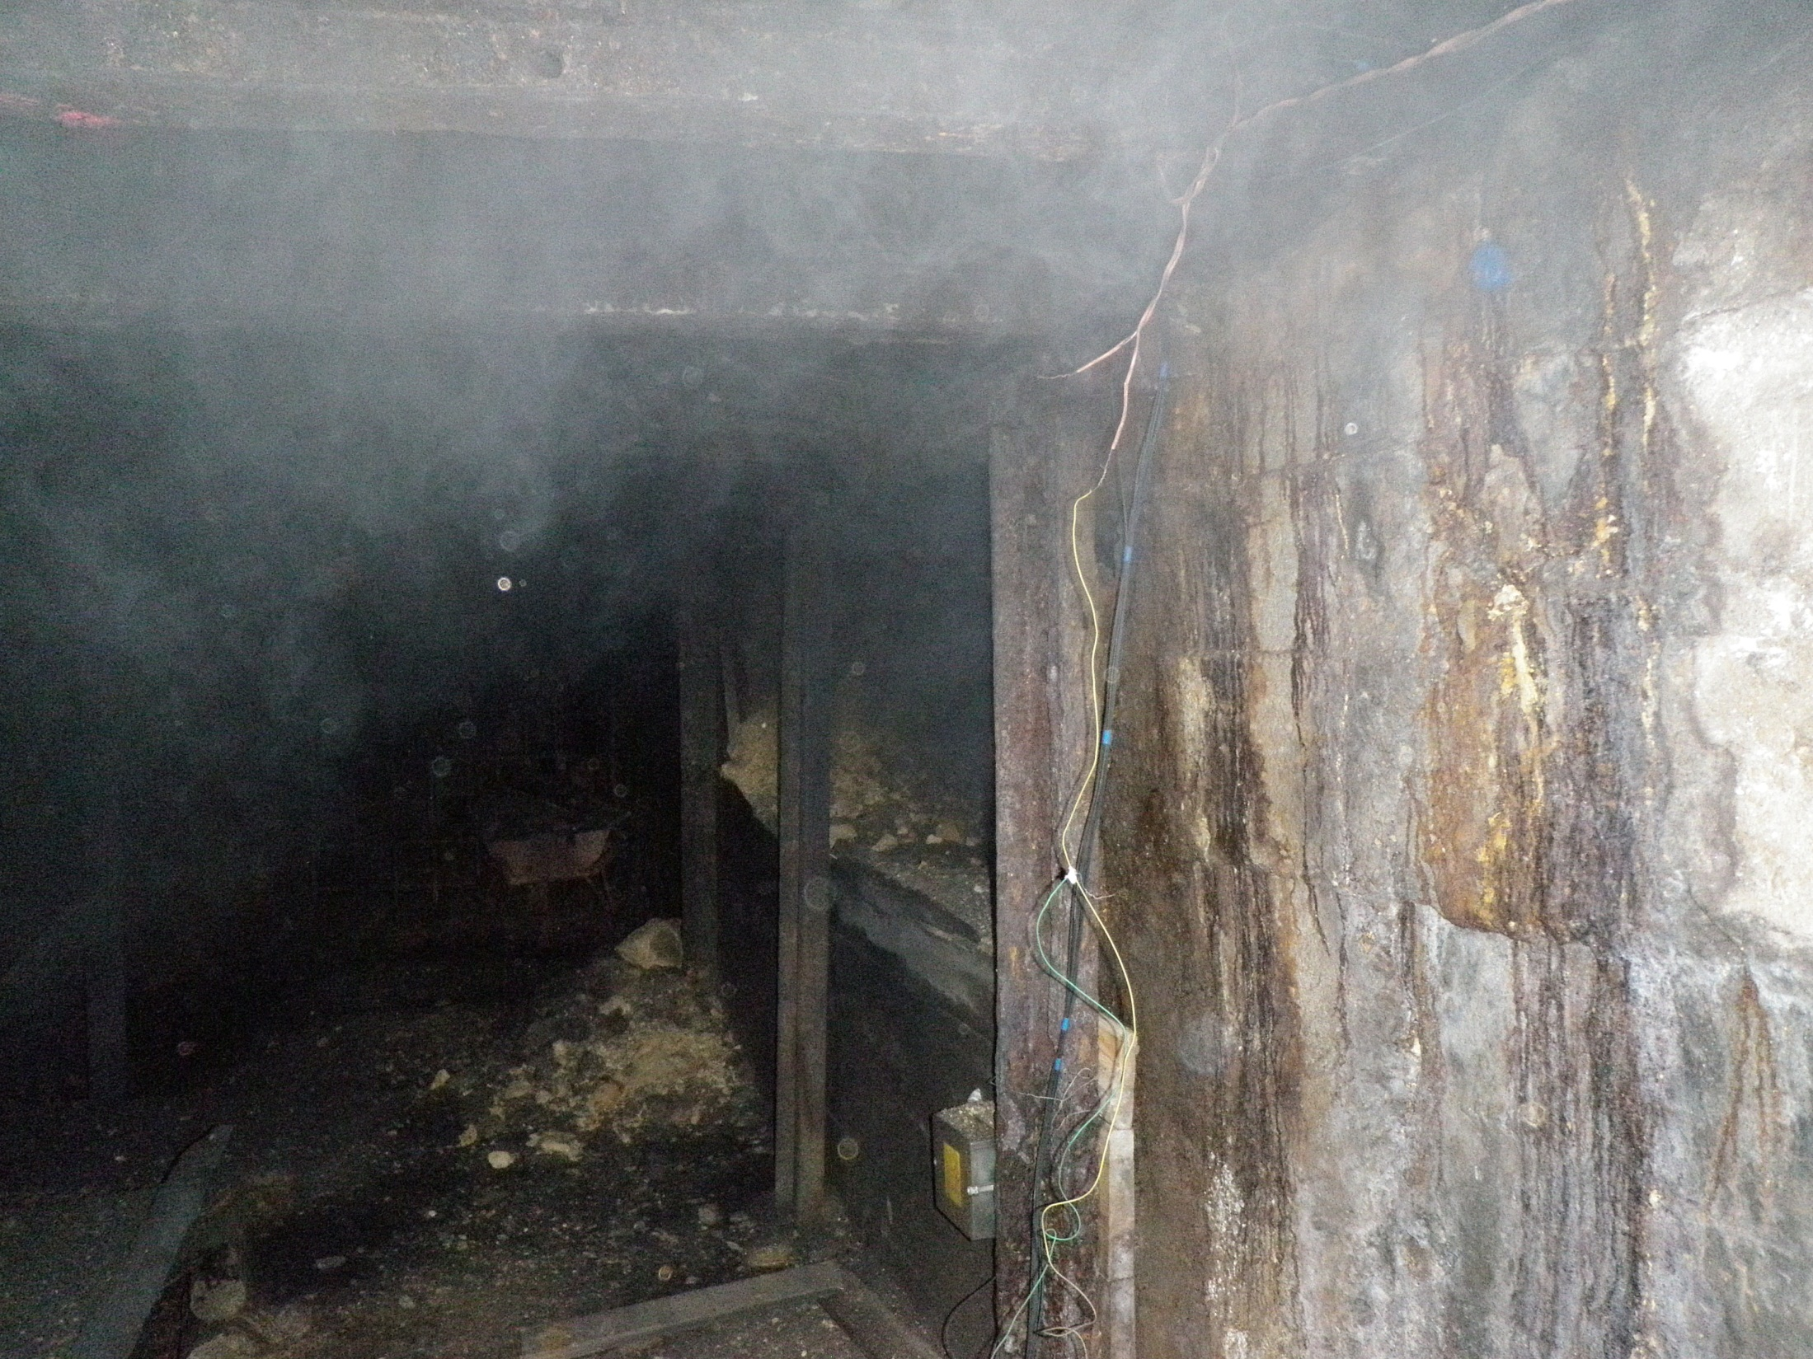
Thanks for your
attention!

