Slide 1
EFFECT OF EXPLOSION CLADDING INDUCED HARDNESS ON SULFIDE STRESS CRACKING AND STRESS CORROSION CRACKING RESISTANCE OF INCONEL 625
May 26, 2014
Notes:
Outline:
Motivation
API 5LD hardness requirement
Environmentally assisted cracking overview
Experimental work
Results
Ongoing work to change specification to accept explosion clad material without exceptions

Slide 2
Background and Motivation
Explosion clad suitability for a specific market is partially driven by the specification requirement of the market
Specifications in the chemical process industry have been written to accommodate some of the inherent features of an explosion clad part
Explosion clad marketability is hindered in other applications by specifications that have been written to address specific issues with other cladding processes
Opening new markets for explosion clad can be eased by working with standardization bodies to adapt existing specifications
American Petroleum Institute Specification 5LD (API 5LD)
NobelClad currently working with API to change spec for next edition
Notes:
The commercial explosion cladding market is driven by the need for corrosion resistant vessels and components in the chemical process industry.

Slide 3
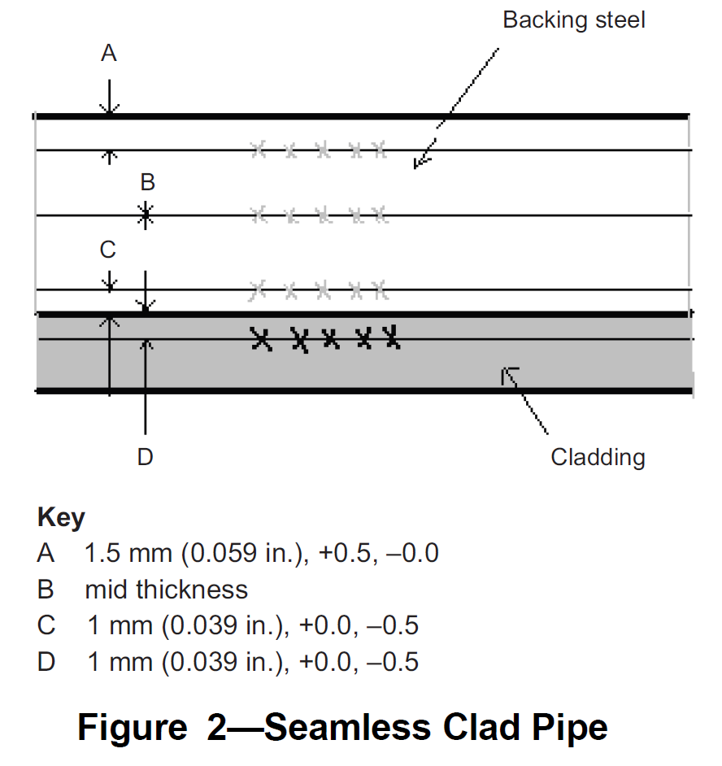
API 5LD – Specification for CRA Clad or lined steel pipe
Specifies requirements for CRA clad or lined pipe used in upstream oil and gas production
Current (March 2009 edition) version requires a hardness traverse in both the base and clad metals 1-mm from the interface
Hardness test is intended to find defects in weld overlay material
Specifically looking for micro-alloying or micro-segregation
From: API 5LD Section 7.13 Hardness Test

Slide 4
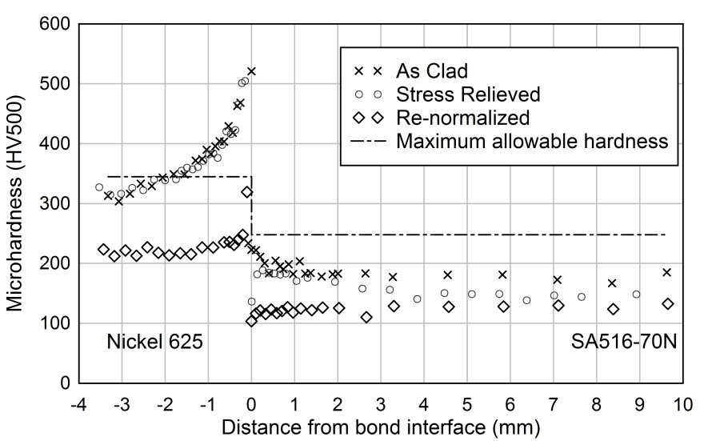
API 5LD Hardness Requirement and Explosion Clad
Specification for hardness in Ni-base alloys is very difficult to meet for explosion clad material
Meeting the required maximum hardness in Ni-base alloys would require re-annealing followed by quench and temper
Eliminates the option for use of explosion clad TMCP steel
, and 40 HRC for explosion welded, cold work induced hardness per ANSI/NACE MR0175/ISO 15156-3:2009(E)
From: API 5LD Section 7.13 Hardness Test
Notes:
Decades of experience in the chemical process industry has shown that increased hardness near the bond zone does not decrease the corrosion resistance of explosion clad materials. The hardening mechanism at work in explosion clad materials (cold work due to severe plastic deformation during the bonding process) is distinctly different than the hardening mechanism (microstructural changes due to micro-compositional changes caused by heating during the fusion welding process) targeted by the API 5LD specification
TMCP steel potentially has fracture toughness features not found in Q&T steels

Slide 5
Changing the Specification
Issue presented to the appropriate API Groups
Task Group on Line Pipe (TGLP)
5LD working group
Resource Group on Sour Service Products (RGSSP) suggested to perform standardized testing for Stress Corrosion Cracking (SCC) and Sulfide Stress Cracking (SSC) on Inconel 625 (UNS NO6625)
Testing based on NACE TM0177-05 Method B using a ASTM G39-99(2005) sample and non-standardized (more severe) test solutions
Testing performed at a range of cold work conditions (surface hardness), test temperatures, and applied stresses

Slide 6
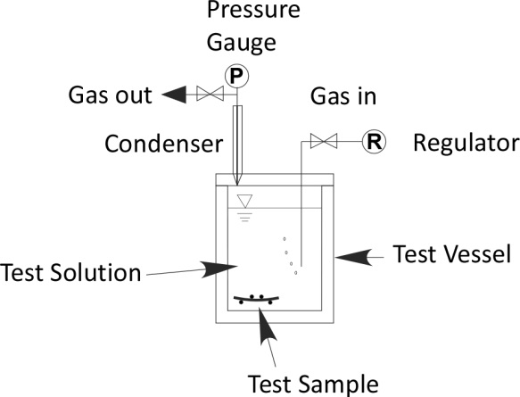
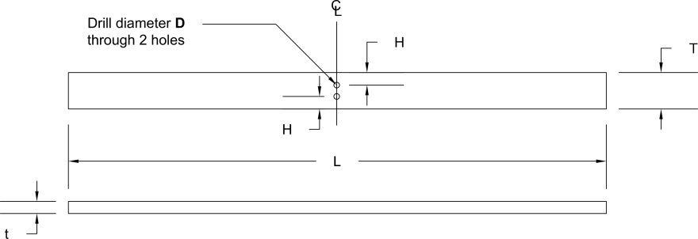
TM0177-05 Method B
Intended to address suitability of materials for use in sour service (upstream oil and gas containing aqueous H₂S)
Exposes material in tension to saturated aqueous H₂S environment for 720 hours (30 days) or until failure
Typically uses a 3 point bend specimen
This testing used 4 point bend specimens as defined by ASTM G39-99(2005)
This testing used a more severe (chloride bearing) solution than standardized in Method B
Dimension | Size
 | mm | inches
L | 67.3 ± 1.3 | 2.65 ± 0.050
t | 1.52 ± 0.13 | 0.060 ± 0.0050
W | 4.57 ± 0.13 | 0.180 ± 0.0050
H | 1.58 ± 0.05 | 0.062 ± 0.002
D | 0.70 ± 0.01 | 0.028 ± 0.0005
Notes:
H₂S at 89 psi

Slide 7
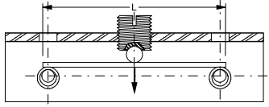
TM0177-05 Method B – Applied Stress on Sample
Test samples are deformed to induce a specified “pseudo-stress” (S) in the sample
Samples from several hardness ranges were tested at several pseudo-stresses
Initially determined by % of actual yield stress in the sample
Psuedo-stress then used to find required sample deformation
D
$$D=\frac{SL^{2}}{6Et}$$
Where:
D = Deflection
S = Pseudo-stress
L = Beam Length
E = Elastic Modulus
t = beam thickness
Hardness (HRC) | Actual Yield Stress (Mpa) | % of AYS to be tested | Psuedo Stress (Mpa)
44 | 1340 | 90 | 1206

Slide 8
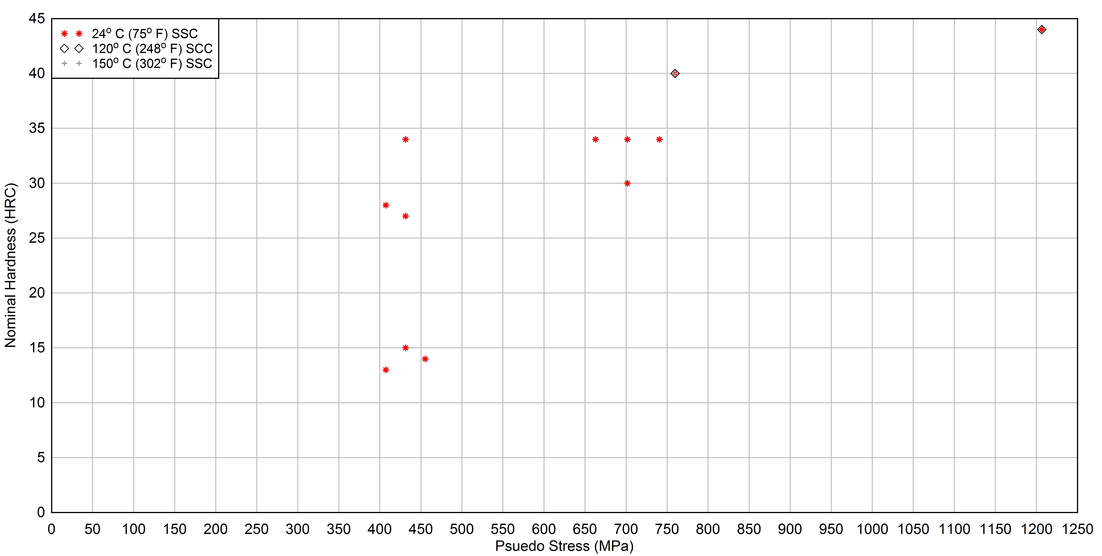
TM0177-05 Method B Specimen Details
All specimens passed
with no cracking

Slide 9
Conclusions and Continuing Work
Explosion welding induced cold work at the bond interface does not cause susceptibility to SSC or SCC in Inconel 625 in the TM0177-05 Method B test with more severe test solutions than standard
M. Blakely and W. Salt are working with the 5LD WG to change the API 5LD spec to allow up to 40 HRC hardness in Ni-based alloys
Revision has been approved by the 5LD WG
Balloting for formal approval for inclusion in the spec will be completed by Mid-June 2014
If revision is approved, it will appear in the 5LD-2014 spec that is due out by the end of the year
Notes:
40 HRC reflects current NACE MR0175/ISO 15156 standard for annealed and cold worked nickel based alloys

Slide 10
Questions?

