Slide 1
LAMINATED METAL–INTERMETALLIC COMPOSITES BY EXPLOSIVE WELDING AND ANNEALING
I. A. Bataev¹, A. A. Bataev¹, V. I. Mali², M. A. Esikov², P. S. Yartsev¹, A.S. Gontarenko¹
1. Novosibirsk State Technical Univestity
2. Lavrentyev Institute of Hydrodynamics SB RAS

Slide 2
Outline
1. Motivation
2. Structure of Al-Ti composite produced by explosive welding
3. Peculiarities of Al₃Ti layer formation during annealing
4. Some results of mechanical tests
5. Conclusion

Slide 3
Motivation
High specific stiffness
High heat resistance
Low density
Good results in fatigue and impact tests
Combining the properties of both the hard and refractory intermetallics and the ductile matrix
“Dilution” of titanium with cheaper aluminum reduces the cost of material

Slide 4
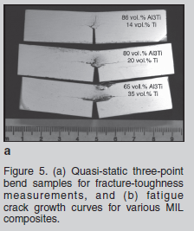
Vecchio KS. Synthetic multifunctional metallic–intermetallic laminate composites. JOM 2005;57:25–31.

Slide 5
Scheme of explosive welding
Al plate – 1mm
Ti plate – 0,5 mm
HE – Ammonite 6GV

Slide 6
Cross-section of explosively welded Al-Ti composite (optical microscopy)

Slide 7
Interface appearance in the upper and lower parts of the composite
Upper part of composite
lower part of composite

Slide 8
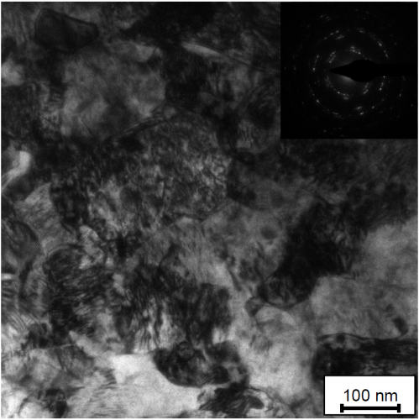
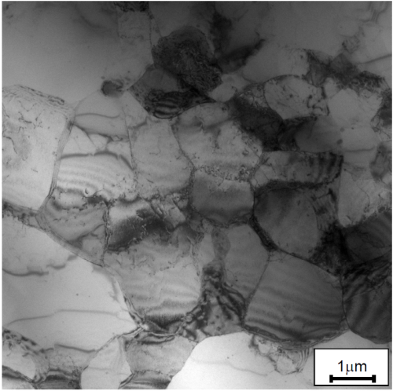
TEM investigation of the interface

Slide 9
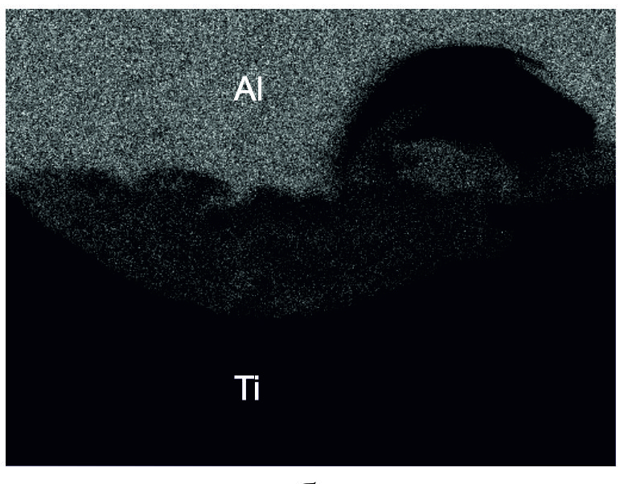
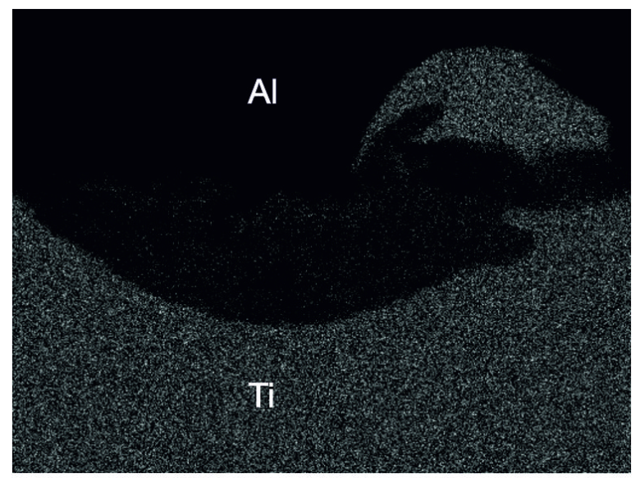
Vortexes arised during explosive welding
Al distribution
Ti distribution

Slide 10
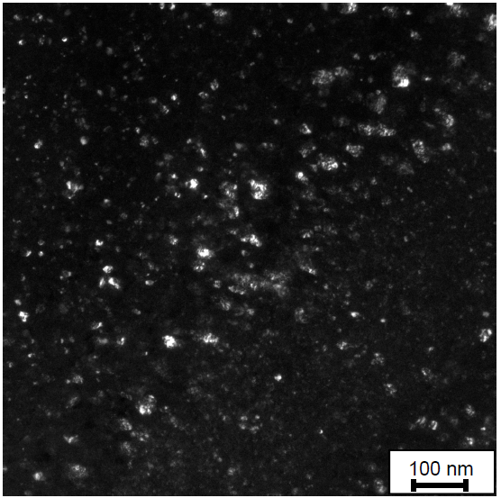
Vortexes structure (TEM)

Slide 11
Dynamic of Al₃Ti layer growth (630 ºC annealing)
1 hour
5 hours
100 hours
Wavy interfaces
plane interfaces

Slide 12
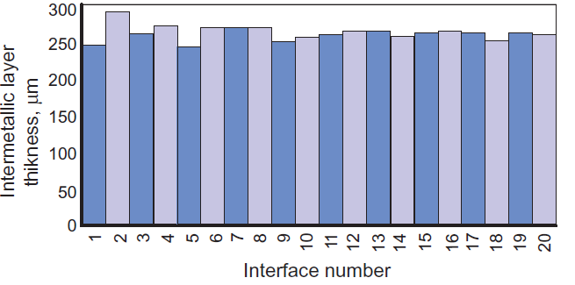
Al₃Ti layer thickness at different interfaces after annealing at 630 ºC
5 hours annealing
100 hours annealing

Slide 13
5 hours at 630 ºC, layer thickness

Slide 14
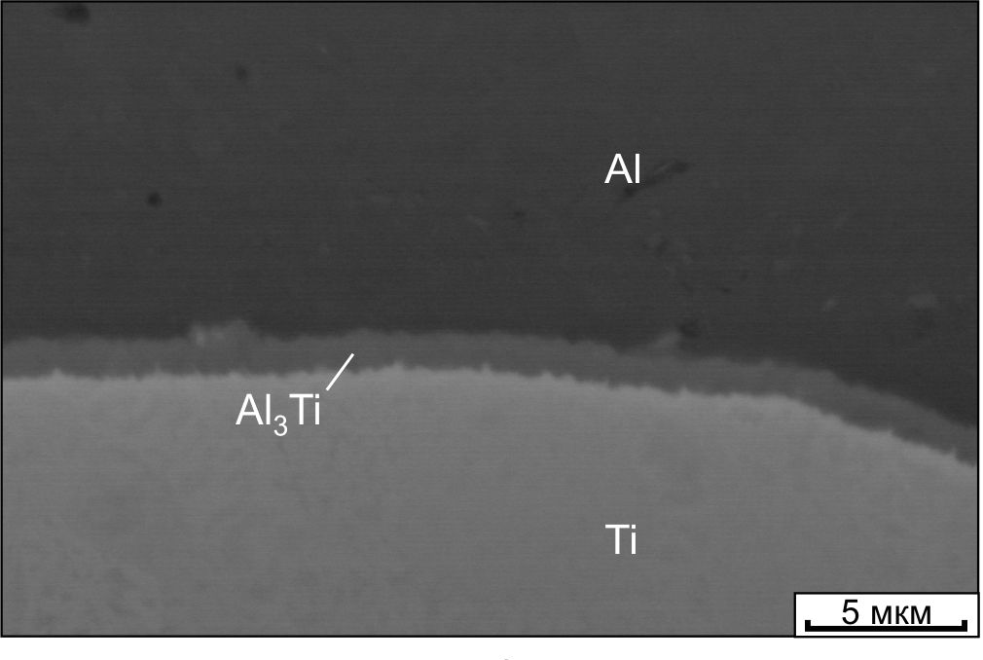
Growth of Al₃Ti at the position of former vortexes
Growth of Al₃Ti at plane interface
630 ºC annealing, 30 min

Slide 15
Scheme of Al₃Ti layer growth

Slide 16
Dependence of intermetallic layer thickness on annealing time

Slide 17
XRD pattern after 100 hours at 630º

Slide 18
TEM of intermetallic layer
Al₃Ti

Slide 19
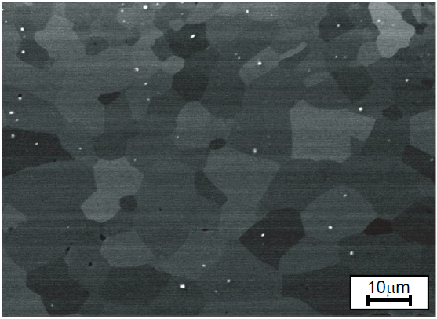
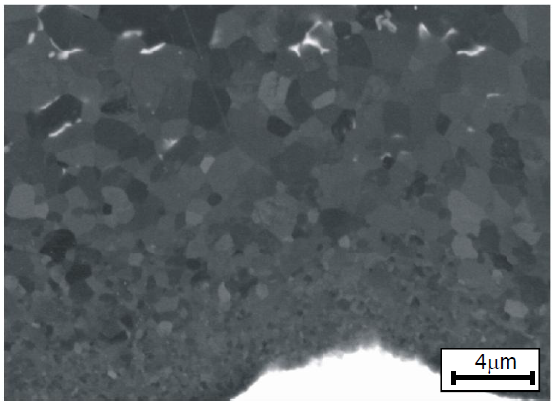
Differences in Al₃Ti grain size in different zones
Near Al
Middle of the Al₃Ti layer
Near Ti
Al
Al3Ti
Ti

Slide 20
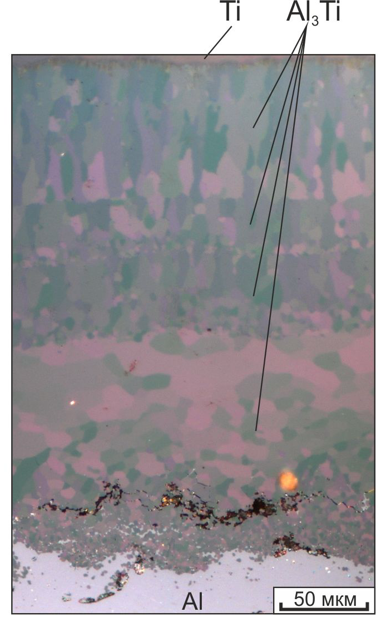
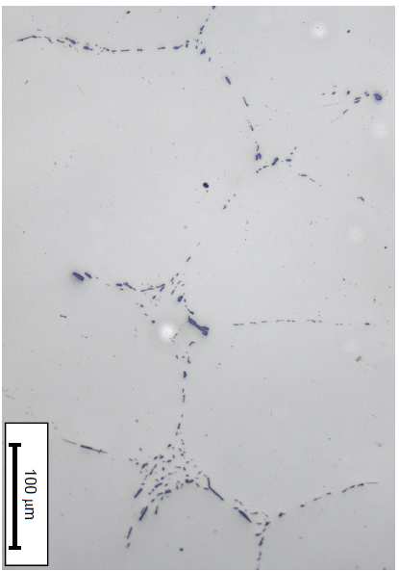
Iron-reach intermetallic precipitations (100 hours 630 ºC)
Dark field OM
Btight field OM
Btight field OM,
Iron-rich precipitation in the Al-layer

Slide 21
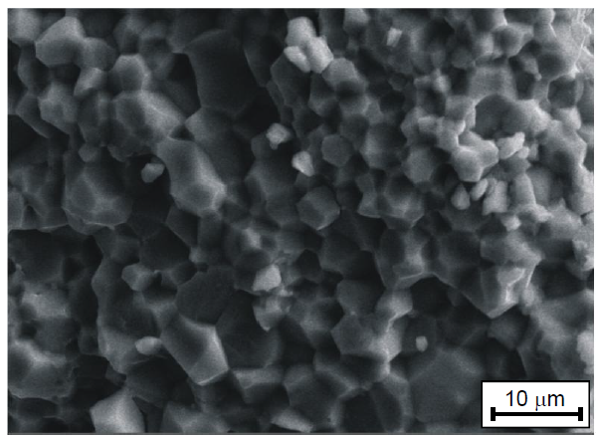
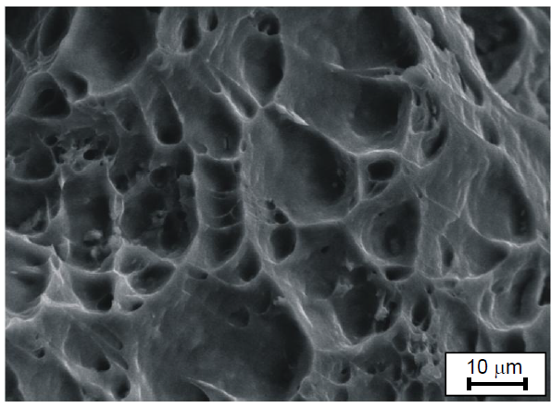
Impact behavior of Al –Al₃Ti – Ti composite
Al –Al₃Ti – Ti
Al – Ti
Al₃Ti
Ti

Slide 22
Scheme of fatigue cracks propagation

Slide 23
Fatigue fracture of Al₃Ti layer

Slide 24
Conclusion
Explosive welding of Ti and Al plates with subsequent annealing is effective technological process for MIL composites production.
Titanium trialuminide (Al₃Ti) is the only intermetallic compound between Al and Ti formed under annealing.
The most favorable place for Al₃Ti growth are former vortexes
The best intermetallic structure is on the Ti-Al₃Ti boundary. On Al-Al₃Ti boundary pores and microcracks were found
One of the most important goals arisen during explosive welding and annealing is addressing the causes of residual stresses, pores and microcracks formation

