Slide 1

Method of Direct Optical Measurement of Flyer Plate Velocity for Explosive Welding
Dr. Vilem Petr, Dr. Stephen Liu, Christoph Hurley
Colorado School of Mines
John Banker, Curtis Prothe
Dynamic Materials Corporation
Last Revision: April 24, 2012

Slide 2
Acknowledgements
For their financial and technical support:
  John Banker
  Curtis Prothe
  Dynamic Materials Corporation

Slide 3
Outline
CSM Method for Measuring Flying Plate Velocity
Numerical modeling of explosively driven flyer plates
Results
Continuing and Future Work

Slide 4
Background
Many formulas available for prediction of flyer plate velocity from explosive loading
Little available data on “explosive energy” of ammonium nitrate (AN) based explosives
A new method of direct optical measurement is used to measure the energy of an AN-based explosive in sheet geometry
Testing of AN-based explosives with charge geometries different than the usage geometry presents problems due to their detonation properties sensitivity to geometric changes
Measurement of energy in a typical explosion welding configuration avoids these problems.

Slide 5
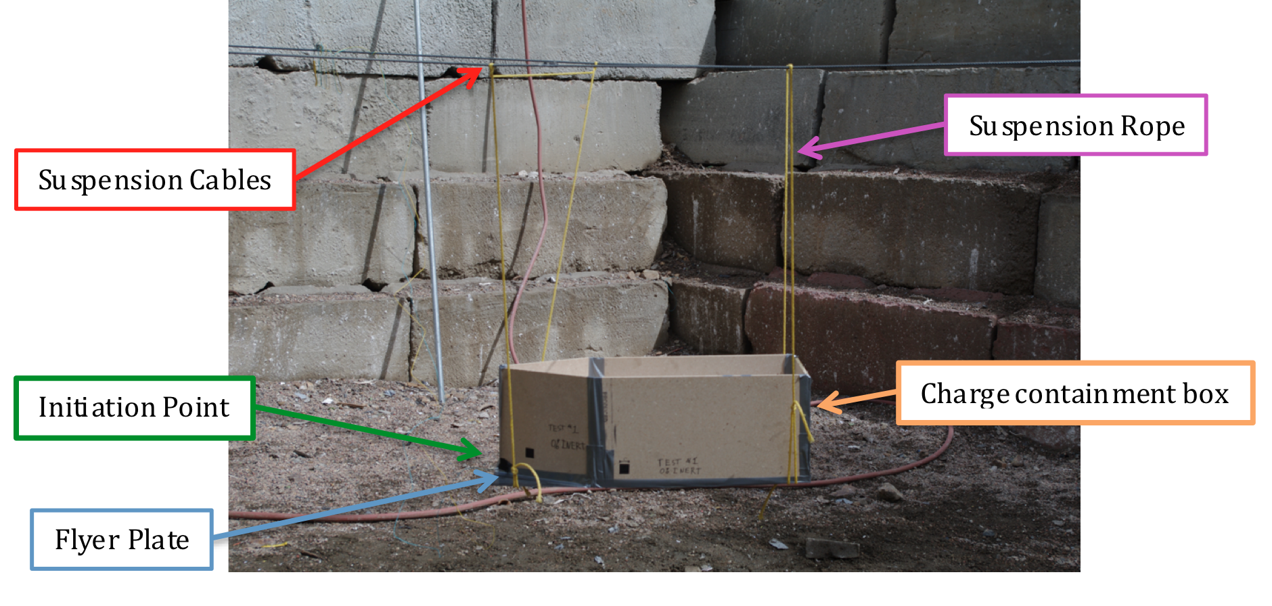
Experimental Design
Flying plate suspended 1-m above ground from steel cables
Particle board box built on top of plate for charge containment
Camera looks at setup from the side at the same elevation as the plate

Slide 6
Experimental Setup
Mix Designs
  Prilled ANFO (R=2; R= Charge mass/plate mass)
  Crushed ANFO + 8% inert material (R=1.99)
Camera setup
  Vision Research Phantom v7.3 high speed video camera
  63,492 fps
  5 µs exposure time
Lighting
  Ambient, outdoor, high-altitude light
Detonation Velocity Measurement
  MREL Handitrap II system
  1-meter probes
Initiation and triggering
  #8 Electric detonator with 20-gram Pentolite booster
  5-volt TTL (digital) trigger from firing system
Notes:
R= explosive mass/plate mass

Slide 7

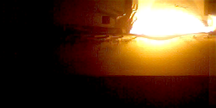
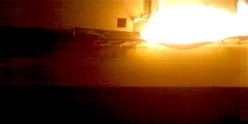
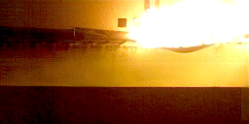
Experimental Results
Frame 1:
Time = 15 µs
Frame 1: Time = 0
Frame 2:
Time = 31 µs
Frame 3:
Time = 47 µs
Frame 2: Time = 52 µs
Frame 4:
Time = 63 µs
Frame 3: Time = 105 µs
Frame rate: 63,492 images per second
Frame 4: Time = 157 µs

Slide 8
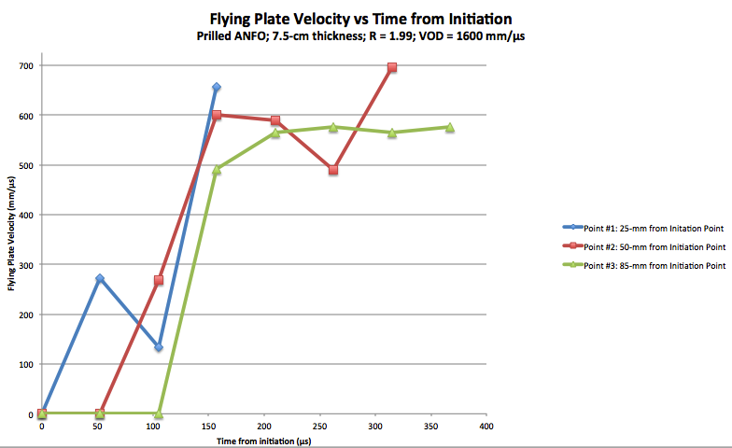
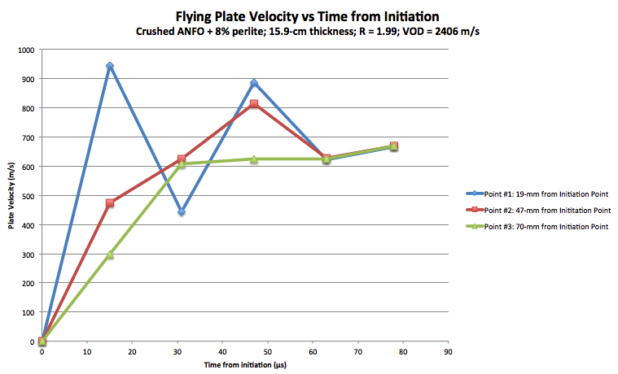
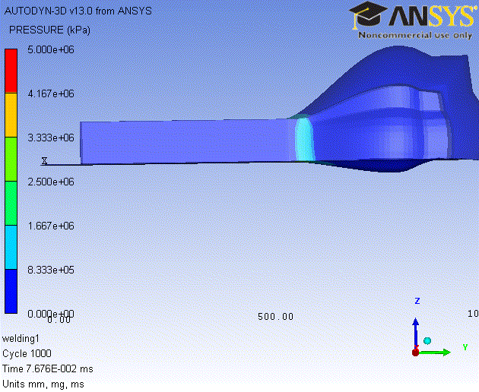
Experimentally Measured Flyer Plate Velocity
Clearly shown instability in plate velocity during explosive DDT (<20-cm from initiation point)
Smooth plate acceleration and velocity curves after stabilization of detonation velocity
Initiation Point
Point 1
Point 3
Point 2

Slide 9
Numerical Model Setup
Flyer plate behavior modeled in ANSYS Autodyne using shell geometry and an Euler-Lagrange coupled solver
Plate and charge geometry matched to experimental setup

Slide 10
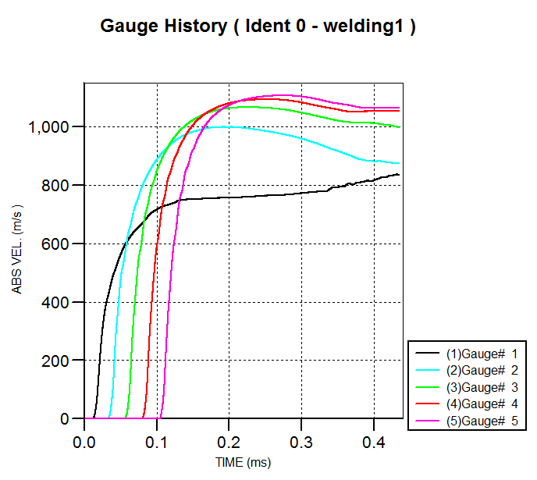
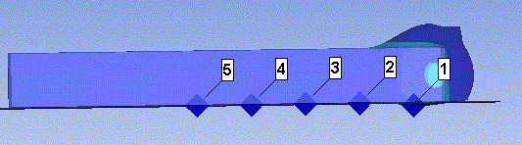
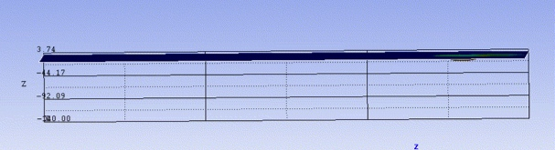
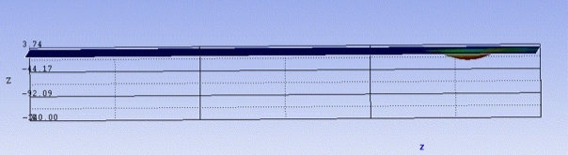
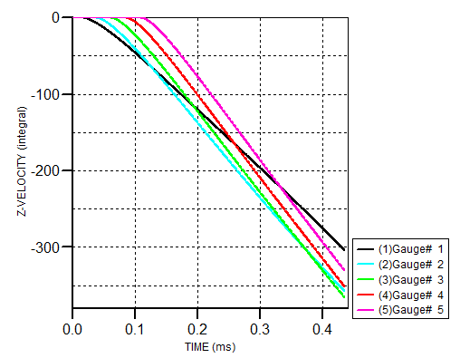
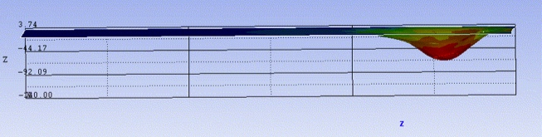
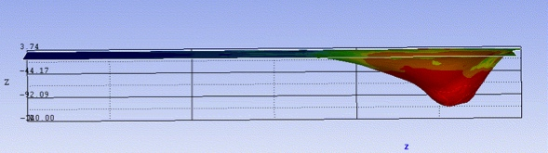
Numerical Modeling Results
Numerical model
Gauges 1-5
Absolute velocity of the plate vs Time
Plate Displacement (mm)
Plate displacement vs Time

Slide 11
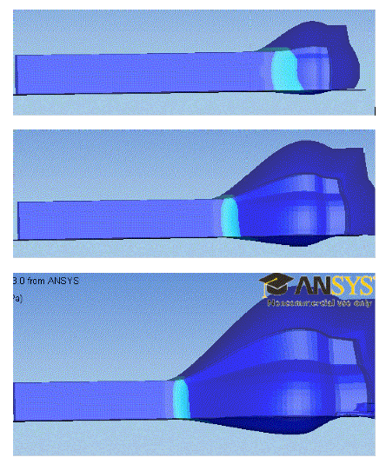
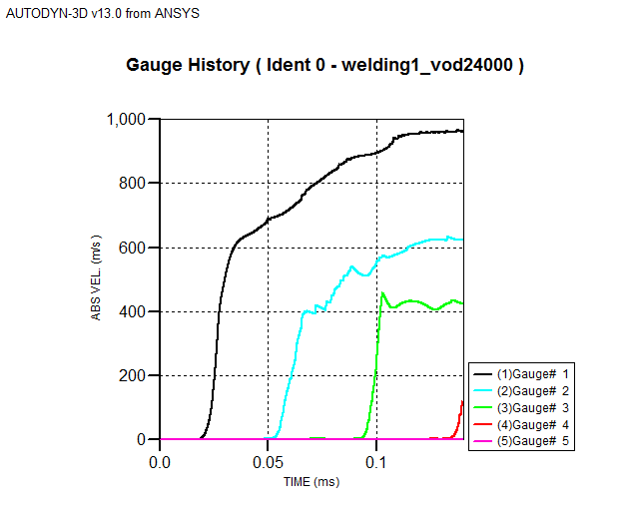
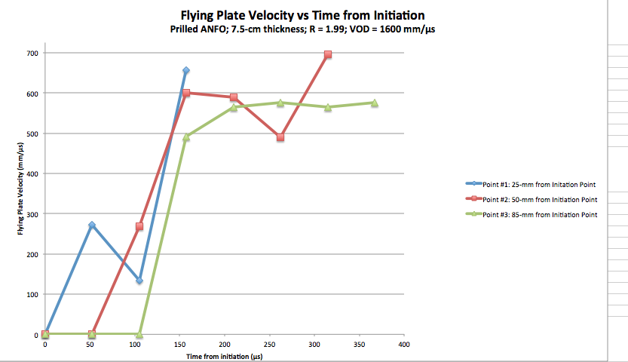
Comparison of Experimental and Numerical Results

Slide 12
Comparison of Measured Flying Plate Velocity with Predicted Values
Experimentally measured velocity is 13-33% slower than predicted by the Cooper method
The slope of the curve fit to experimental data is shallower and shifted up from previously proposed predictive methods
 | VOD (m/s) | Experimental Plate Velocity (m/s) | Predicted Plate Velocity (Gurney) (m/s) | Numerical Model Plate Velocity (m/s)
Prilled ANFO | 1600 | 576 | 633 | 970
ANFO + 8% Inert | 2406 | 668 | 951 | 1063
ANFO + 14% Inert | 1976 | - | 781 | -
Notes:
Measurement error ~ 2% (from spatial error on image x 2)
Post blast gas pressure ~ 2500 MPa

Slide 13
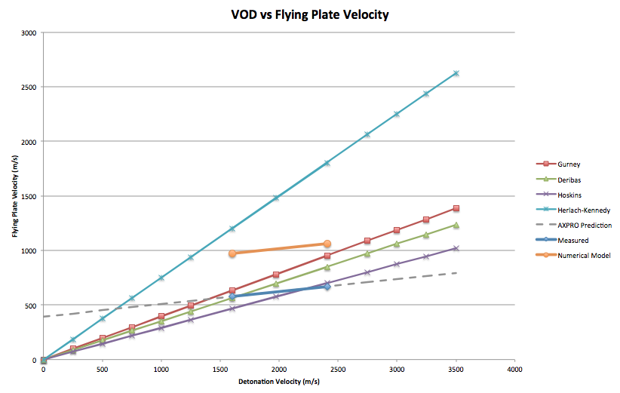
Comparison of Measured Flying Plate Velocity with Predicted Values
Prilled ANFO
ANFO + 8% Inert Material

Slide 14
Ongoing and Future Work
Ongoing work:
  Fill out ANFO-based explosive data set using CSM AXPRO Mobile High Fidelity Detonation Physics Laboratory (MHFDPL)
    Ultra-high speed fast framing camera (Specialised Imaging SIMX)
    2-head flash X-ray
    8-point photon doppler velocimetry
  Validate previously reported flying plate acceleration predictions
  Directly measure plate deformation behavior using CSM AXPRO MHFDPL

Slide 15
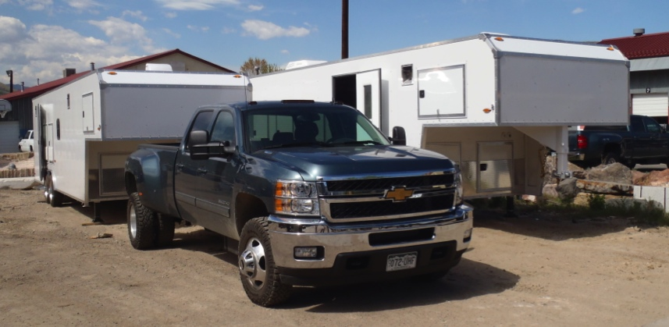
Mobile High Fidelity Detonation Physics Laboratory
Enable high fidelity field measurements of explosive properties and behavior
Laboratory consists of wirelessly linked:
  Command trailer
  Instrumentation trailer
    Ultra high speed framing camera
    High intensity illumination
    Flash X-ray
    Photon Doppler Velocimeter
    High Speed video camera
    Manganin gages
    PZT probes
    Expandable for new and customized instrumentation

Slide 16
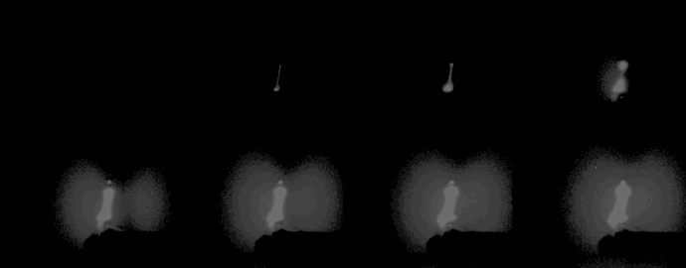
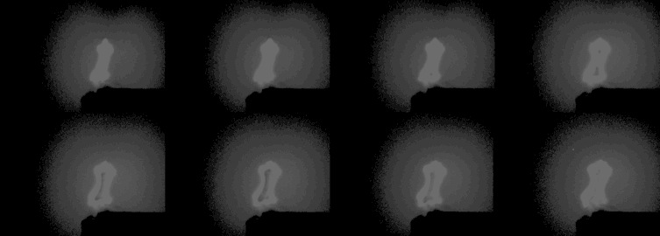
Ultra High Speed, High Resolution Framing Camera
Specialised Imaging SIM D camera (Model SIMD16)
  Up to 300,000,000 frames/second
  16 frames
  1280x960 image resolution
Exploding Bridgewire Laboratory Test
1
3
2
4

Slide 17
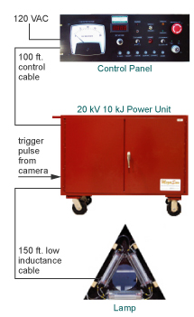
High Intensity Illumination System
MegaSun 700µs flash system
  High-voltage (10 - 20kV) zenon flash lamps
  1.6 gigalumens
  Enables high quality (low noise) images to be captured at ultra-high frame rates (>100M fps)

Slide 18
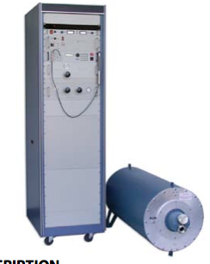
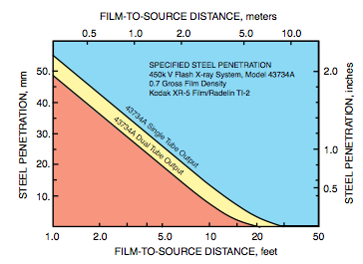
Flash X-Ray System
L3 Communications Pulserad 2-head flash x-ray imaging system
450 keV x-ray power

Slide 19
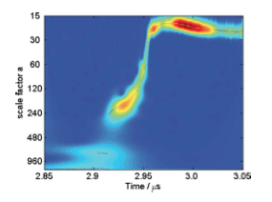
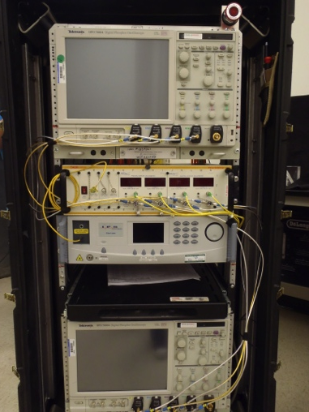
Photon Doppler Velocimetry (PDV)
High precision, field deployable laser interferometry technique
Capable of measuring plate velocity at up to eight (8) discrete points on bottom of plate
Enables the direct measurement of plate deformation, edge effects, dynamic bend angle, plate acceleration

Slide 20
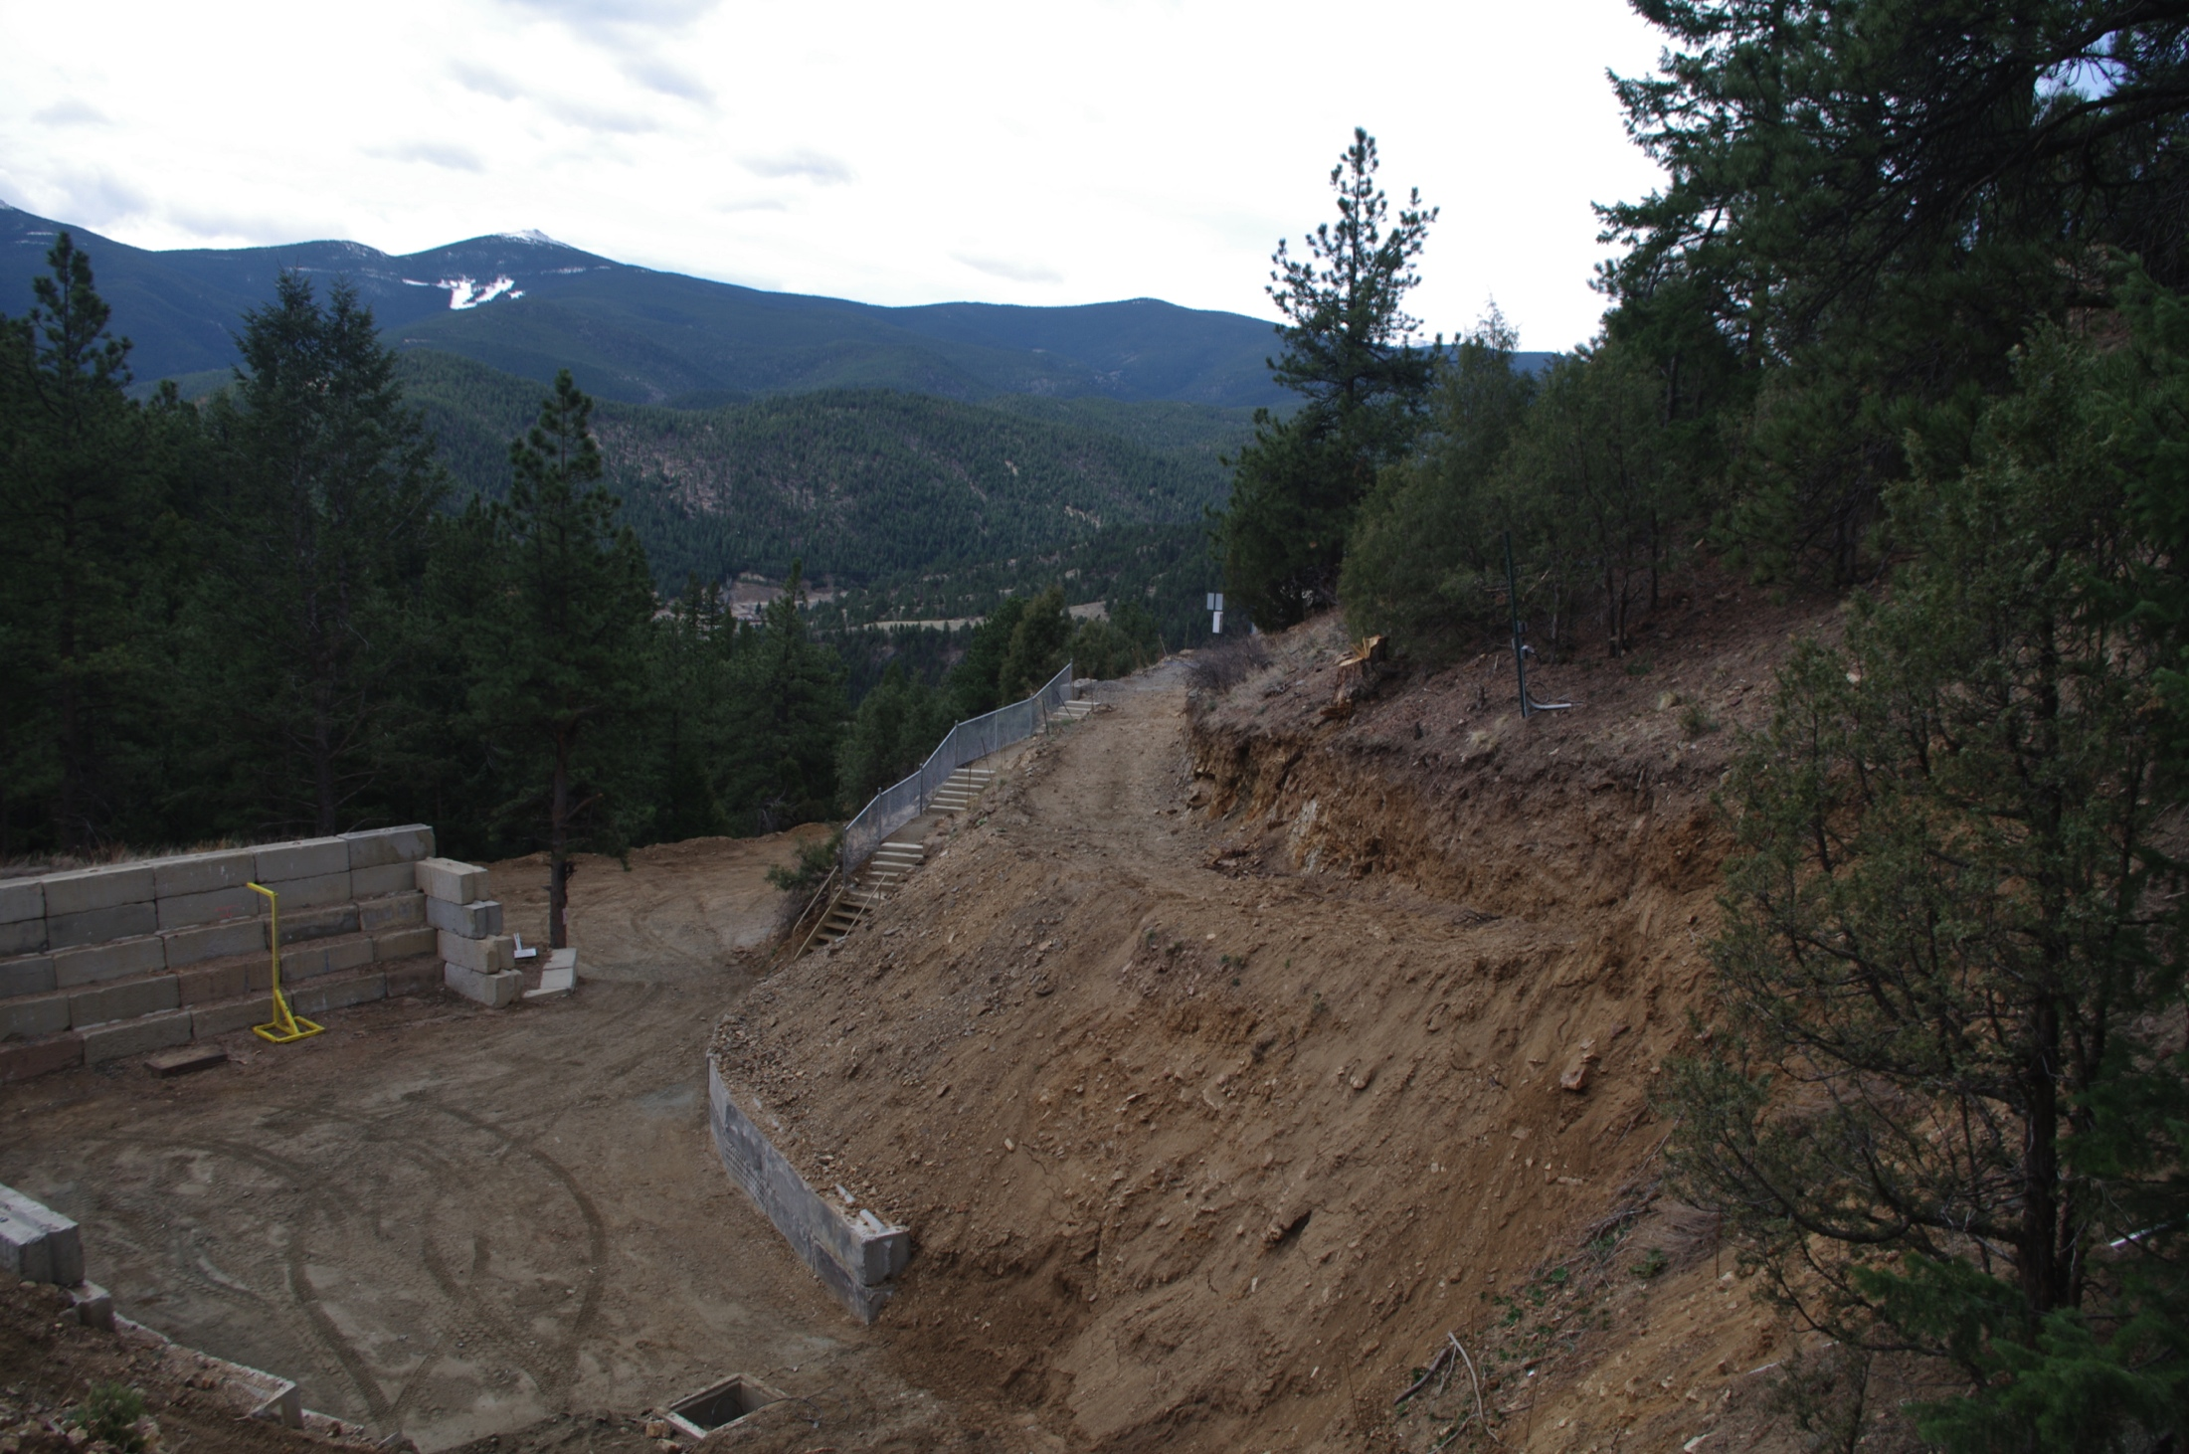
Conclusions
This method allows the direct, optical measurement of flyer plate velocity for the open-face sandwich charge configuration
This technique provides an inexpensive, safe, repeatable method to measure flyer plate behavior under various explosive loads
CSM AXPRO experimental and numerical results show excellent agreement
This method will enable the testing of the effect of varying explosive properties on flyer plate velocity
The new proposed method using the CSM AXPRO MHFDPL will allow the precise study of flyer plate behavior and explosive energy

Slide 21
Questions?

